Slide 1
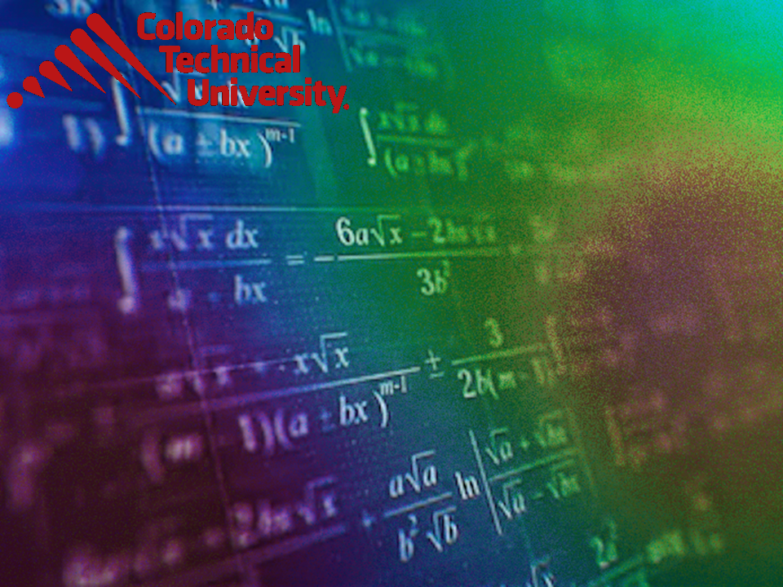
Welcome to
Unit 2 ! .
MATH 205 Differential Calculus
https://www.smu.edu.sg/programmes/core-curriculum/course-structure/calculus

Slide 2
What’s Up?
Outcome 2) Use algebra and limits to examine the properties and graphs of functions
Outcome 7) Solve problems by identifying the requirements, making a sketch as appropriate, and using calculus techniques to model the problem, calculating the final answer and verifying the solution

Slide 3
Mathematical Modeling
A mathematical model is a mathematical description (often by means of a function or an equation) of a real-world phenomenon

Slide 4
Mathematical Modeling
Mathematical Models
(real-world formulas)
are usually polynomial equations

Slide 5
Mathematical Modeling
The purpose of the model is to understand the phenomenon and often to make predictions about future behavior (forecasts)

Slide 6
Mathematical Modeling
A mathematical model is never a completely accurate representation of a physical
situation

Slide 7
Mathematical Modeling
Unless it was developed as part of a scientific experiment to validate the particular relationship, there is no scientific evidence to show a particular model accurately explains a phenomenon

Slide 8
Mathematical Modeling
Still, it may be useful for forecasting

Slide 9
Mathematical Modeling
“Forecasts are expectations. The future can fail to meet expectations.”
Stephanie Black, 2022
Thanks, Stephanie!

Slide 10
Mathematical Modeling
Functions are often used to model real-world phenomena

Slide 11
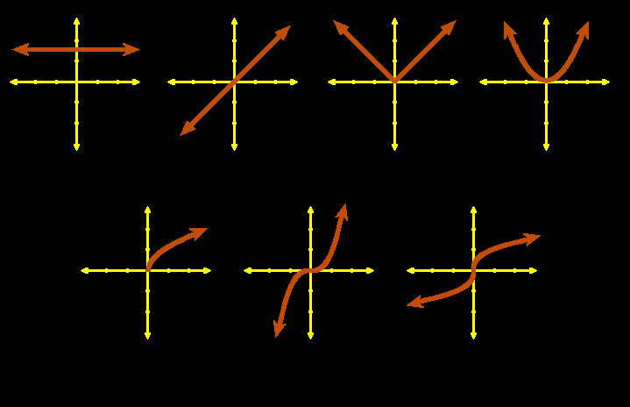
Mathematical Modeling
Graphs of common algebraic functions:
constant identity abs value quadratic
square root cubic cube root
VFrench, 2010

Slide 12
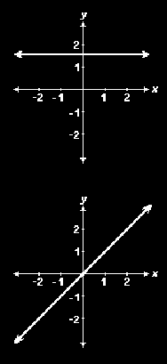
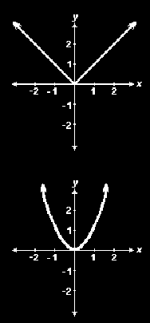
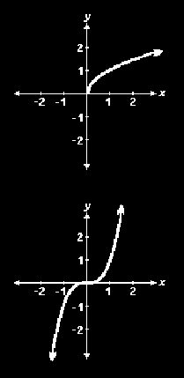
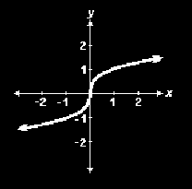
GRAPHS OF COMMON FUNCTIONS
IN-CLASS PROBLEM 1
Which function?
constant identity abs value quadratic
square root cubic cube root
Vfrench, 2010

Slide 13
Mathematical Modeling
We use these known functions to see if they will fit our observed data because we know their mathematical formulas
It’s a place to start!

Slide 14
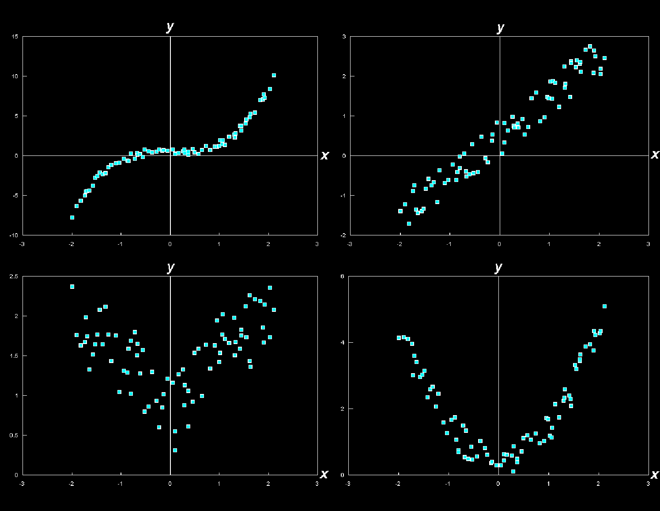
GRAPHS OF COMMON FUNCTIONS
IN-CLASS PROBLEM 2
Which might fit?
constant line abs value quadratic
VFrench, 2010
square root cubic cube root

Slide 15
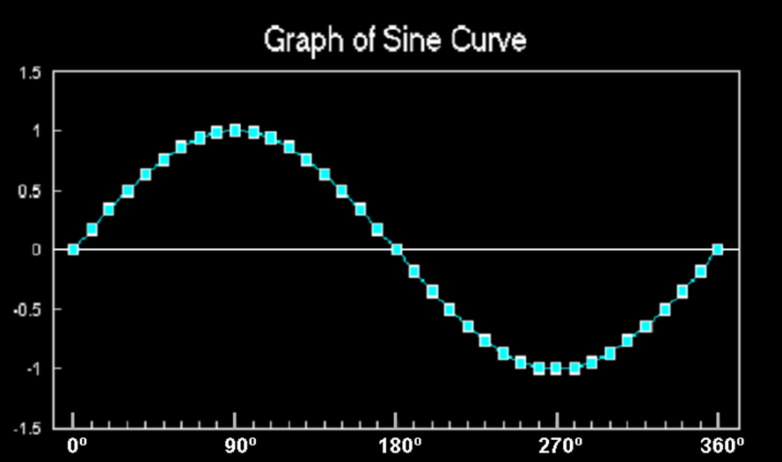
Mathematical Modeling
Trig functions (especially sine and cosine) are used to model cyclical phenomena
VFrench, 2015

Slide 16
Mathematical Modeling
Exponential functions use:
ƒ(x) = a^{x}
where the base
a is a positive
constant
https://www.quora.com/How-do-you-find-the-domain-and-range-of-an-exponential-function

Slide 17
Mathematical Modeling
Logarithmic functions use:
ƒ(x) = log_{a}x
where the base a is a positive constant
https://en.wikipedia.org/wiki/Logarithm

Slide 18

Questions?
http://i.imgur.com/aliTlT3.jpg

Slide 19
Mathematical Modeling
Because data RARELY fits the known functions exactly, we have to transform the functions to fit the data

Slide 20
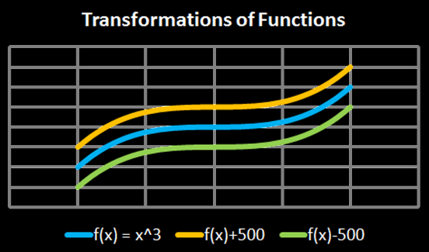
Transforming Functions
vertical shifts:
ƒ(x) + c plus shifts up
ƒ(x) - c minus shifts down
Vfrench, 2010

Slide 21
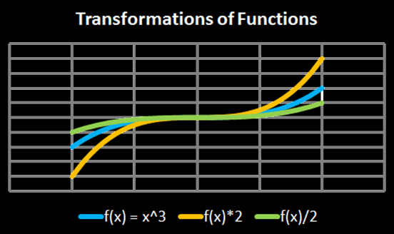
Transforming Functions
vertical stretch:
ƒ(x) × c stretches
ƒ(x) ÷ c squashes
Vfrench, 2010

Slide 22
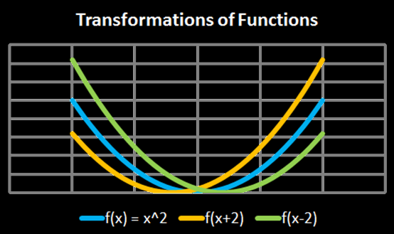
Transforming Functions
horizontal shifts:
ƒ(x + c) shifts left
ƒ(x - c) shifts right
Vfrench, 2010

Slide 23
Transforming Functions
Another way to look at it:
y-transformations affect the graph but keep the graph paper the same
x-transformations keep the graph the same but modify the graph paper

Slide 24
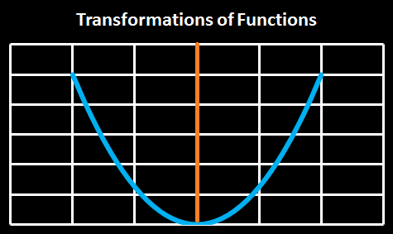
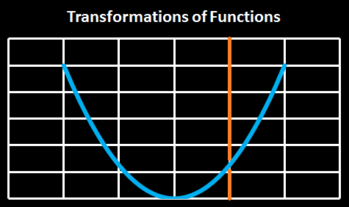
Transforming Functions
ƒ(x + c)
shifts the
origin right
(which shifts
the graph left)
Vfrench, 2010

Slide 25
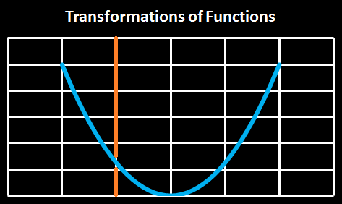
Transforming Functions
ƒ(x - c)
shifts the
origin left
(which shifts
the graph
right)
Vfrench, 2010

Slide 26
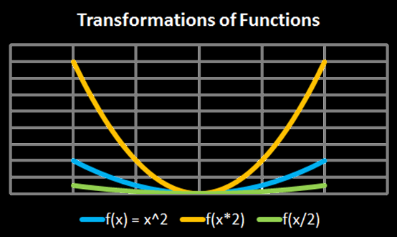
Transforming Functions
horizontal shifts:
ƒ(x × c) squashes
ƒ(x ÷ c) stretches
Vfrench, 2010

Slide 27
Transforming Functions
Any operations done to the function outside of the parentheses affects the “y” values
These operations lead to an intuitive result

Slide 28
Transforming Functions
Any operations done to the function inside the parentheses affects the “x” values
These operations lead to a counterintuitive result

Slide 29
GRAPHS OF COMMON FUNCTIONS
IN-CLASS PROBLEM 3
Which is the transform
ƒ(x) - 2?
ƒ(x)
a)
b)
c)
1
1
1
1
Vfrench, 2020

Slide 30
GRAPHS OF COMMON FUNCTIONS
IN-CLASS PROBLEM 3
Which is the transform
ƒ(x) - 2?
ƒ(x)
a)
b)
c)
Vfrench, 2020

Slide 31
GRAPHS OF COMMON FUNCTIONS
IN-CLASS PROBLEM 3
Which is the transform
2ƒ(x)?
a)
b)
c)
ƒ(x)
Vfrench, 2020

Slide 32
GRAPHS OF COMMON FUNCTIONS
IN-CLASS PROBLEM 3
Which is the transform
2ƒ(x)?
a)
b)
c)
ƒ(x)
Vfrench, 2020

Slide 33
GRAPHS OF COMMON FUNCTIONS
IN-CLASS PROBLEM 3
Which is the transform
ƒ(x – 1)?
a)
b)
c)
ƒ(x)
Vfrench, 2020

Slide 34
GRAPHS OF COMMON FUNCTIONS
IN-CLASS PROBLEM 3
Which is the transform
ƒ(x – 1)?
a)
b)
c)
ƒ(x)
Vfrench, 2020

Slide 35
GRAPHS OF COMMON FUNCTIONS
IN-CLASS PROBLEM 3
Which is the transform
ƒ(2x)?
a)
b)
c)
ƒ(x)
Vfrench, 2020

Slide 36
GRAPHS OF COMMON FUNCTIONS
IN-CLASS PROBLEM 3
Which is the transform
ƒ(2x)?
a)
b)
c)
ƒ(x)
Vfrench, 2020

Slide 37
Questions?
www.career.gatech.edu

Slide 38
Graphs of Trig Functions
The graph of sin undulates back and forth
It has a value of 0 at 0°
VFrench, 2015

Slide 39
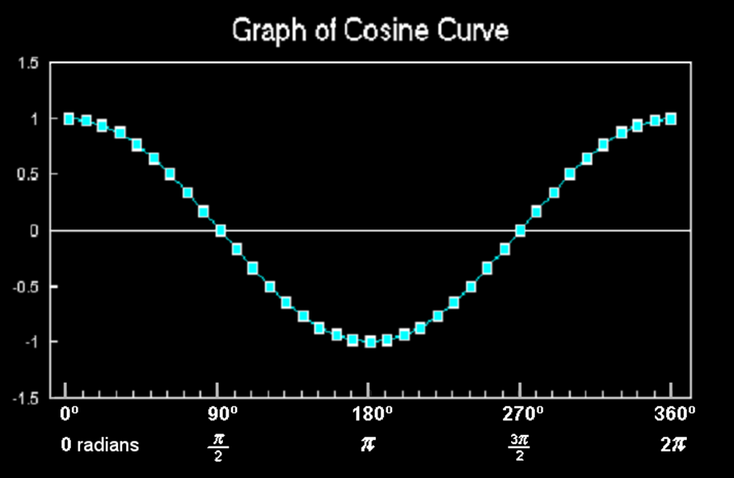
Graphs of Trig Functions
The graph of cos also undulates back and forth
It doesn’t have a value of 0 at 0°
VFrench, 2015

Slide 40
Graphs of Trig Functions
Sines and cosines are useful because of the shape of their curves
Many natural phenomena undulate back and forth

Slide 41
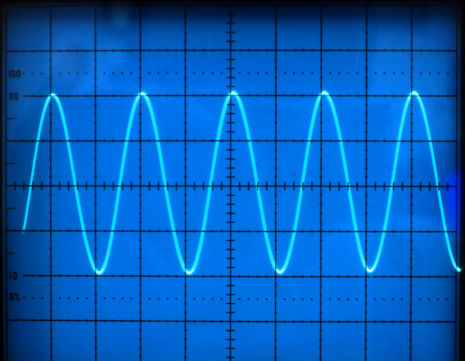
Graphs of Trig Functions
http://www.t4science.com/images/general/frequency.jpg

Slide 42
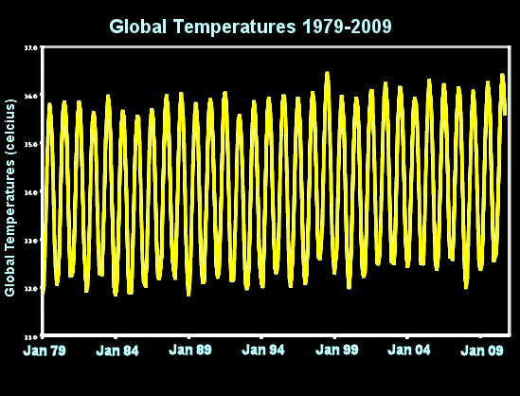
Graphs of Trig Functions
VFrench, 2012

Slide 43
Graphs of Trig Functions
A lot of mathematical models for real-world phenomena have a “sine” or “cosine” in them to include this cyclical pattern

Slide 44
Graphs of Trig Functions
A tangent isn’t important because it is a useful graph shape for mathematical modeling
A tangent is useful because it is a slope ($\frac{rise}{run}$)

Slide 45
Graphs of Trig Functions
The secant is used (briefly) in calculus

Slide 46
Questions?
www.career.gatech.edu

Slide 47
Transforming Functions
General form of trig functions:
y = A sin (Bx - C) + D
y = A cos (Bx - C) + D

Slide 48
Transforming Functions
General form of trig functions:
y = A sin (Bx - C) + D
y = A cos (Bx - C) + D
They put in a minus sign so that when you add a value to the “x” it will move the function to the (intuitive) right!

Slide 49
Transforming Functions
y = A sin (Bx - C) + D
“A” stretches the graph up and down – “Amplitude”

Slide 50
Transforming Functions
y = A sin (Bx - C) + D
“A” stretches the graph up and down – “Amplitude”
“B” stretches the graph side to side – “Period” “frequency”

Slide 51
Transforming Functions
y = A sin (Bx - C) + D
“A” stretches the graph up and down – “Amplitude”
“B” stretches the graph side to side – “Period” “frequency”
“C” moves the graph side to side – “Phase shift”

Slide 52
Transforming Functions
y = A sin (Bx - C) + D
“A” stretches the graph up and down – “Amplitude”
“B” stretches the graph side to side – “Period” “frequency”
“C” moves the graph side to side – “Phase shift”
“D” moves the graph up and down – “Vertical shift”

Slide 53
How It’s Used
Applying transformations to sound waves results in effects that are prevalent in audio industries: altering pitch, and amplifying or diminishing sound waves and their echoes

Slide 54
How It’s Used
Transformed sound waves can be combined, resulting in a different quality of sound - the difference between a voice and a violin, for instance, or between two different voices

Slide 55
How It’s Used
Synthesizers use these combinations to recreate the sounds of common musical instruments

Slide 56
Transforming Functions
Excel demo

Slide 57
Questions?
www.career.gatech.edu

Slide 58
The secret word for this unit is:
CATNIP

Slide 59
Limits
In Unit 1 Part 1 we looked at the limits of sequences

Slide 60
Calculating Limits
In Unit 1 Part 1 we looked at the limits of sequences
You can do the same thing with algebraic functions

Slide 61
CALCULATING LIMITS
IN-CLASS PROBLEM 4
Find: lim (6x² – 3x + 5)
x → 0
Just plug in x = 0 and solve!

Slide 62
CALCULATING LIMITS
IN-CLASS PROBLEM 4
Find: lim (6x² – 3x + 5)
x → 0
= 5

Slide 63
Calculating Limits
Even if functions are not the same, their limits at some target point may be the same
A
https://www.mathsisfun.com/calculus/limits.html

Slide 64
Questions?
http://i.imgur.com/aliTlT3.jpg

Slide 65
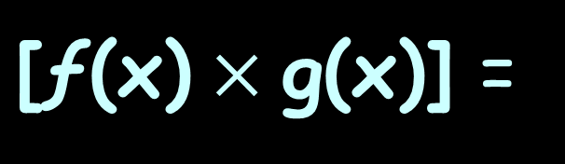


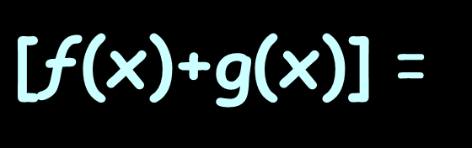

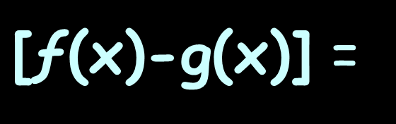



Calculating Limits
Rules for Limits:
lim
x→a
$\text{[ƒ(}\text{x}\text{)+}\text{g}\text{(}\text{x}\text{)]}$ =
lim
x→a
$\text{ƒ(}\text{x}\text{)}$ $\text{+}$
lim
x→a
$$\text{g}\text{(}\text{x}\text{)}$$
lim
x→a
$\text{[ƒ(}\text{x}\text{)}\text{−}\text{g}\text{(}\text{x}\text{)]}$ =
lim
x→a
$\text{ƒ(}\text{x}\text{)}$ $\text{−}$
lim
x→a
$$\text{g}\text{(}\text{x}\text{)}$$
lim
x→a
$\text{[ƒ(}\text{x}\text{)}×\text{g}\text{(}\text{x}\text{)]}$ =
lim
x→a
$\text{ƒ(}\text{x}\text{)}$ $×$
lim
x→a
$$\text{g}\text{(}\text{x}\text{)}$$

Slide 66
CALCULATING LIMITS
IN-CLASS PROBLEM 5
Find: lim (6x³ – 3x² + 5x)
x → 0
That would be the same as:
6x³ - 3x² + 5x
lim
x→0
lim
x→0
lim
x→0

Slide 67
CALCULATING LIMITS
IN-CLASS PROBLEM 5
Find: lim (6x³ – 3x² + 5x)
x → 0
That would be the same as:
6x³ - 3x² + 5x
= 0 - 0 + 0
= 0
lim
x→0
lim
x→0
lim
x→0

Slide 68
Questions?
http://i.imgur.com/aliTlT3.jpg

Slide 69
CALCULATING LIMITS
IN-CLASS PROBLEM 6
The position (in feet) of an object moving along a line is:
s(t) = -16t² +128t
Find the average speed over the time interval 1sec ≤ t ≤ 2sec

Slide 70
CALCULATING LIMITS
IN-CLASS PROBLEM 6
s(t) = -16t² + 128t 1≤t≤2
First evaluate the function at the final value: 2
Then evaluate the function at the initial value: 1

Slide 71
CALCULATING LIMITS
IN-CLASS PROBLEM 6
s(t) = -16t² + 128t
s(2) = -16(2²) + 128(2)
= -64 + 256 = 192
s(1) = ?

Slide 72
CALCULATING LIMITS
IN-CLASS PROBLEM 6
s(t) = -16t² + 128t
s(2) = -16(2²) + 128(2)
= -64 + 256 = 192
s(1) = -16(1²) +128(1)
= -16 + 128 = 112

Slide 73
CALCULATING LIMITS
IN-CLASS PROBLEM 6
The average speed will be:
(s(final t) – s(initial t))
(final t – initial t)
s(2) = 192
s(1) = 112

Slide 74
CALCULATING LIMITS
IN-CLASS PROBLEM 6
The average speed will be:
(s(final t) – s(initial t))
(final t – initial t)
In this case:
(192 – 112) / (2 - 1) = ?

Slide 75
CALCULATING LIMITS
IN-CLASS PROBLEM 6
The average speed will be:
(s(final t) – s(initial t))
(final t – initial t)
In this case:
(192 – 112) / (2 - 1) = 80/1
= 80 is it?

Slide 76
CALCULATING LIMITS
IN-CLASS PROBLEM 6
The average speed will be:
(s(final t) – s(initial t))
(final t – initial t)
In this case:
(192 – 112) / (2 - 1) = 80/1
= 80 ft/sec

Slide 77
CALCULATING LIMITS
IN-CLASS PROBLEM 7
The position (ft) of an object moving along a line is:
s(t) = -16t² +128t
Find the average speed over the interval 1sec ≤ t ≤ 1.5sec
Avg speed =
(s(final t) – s(initial t))
(final t – initial t)

Slide 78
CALCULATING LIMITS
IN-CLASS PROBLEM 7
s(t) = -16t² + 128t
s(1.5) = -16(1.5²) + 128(1.5)
= -36 + 192 = 156
s(1) = -16(1²) +128(1)
= -16 +128 = 112
So the average speed is: ?
Avg speed =
(s(final t) – s(initial t))
(final t – initial t)

Slide 79
CALCULATING LIMITS
IN-CLASS PROBLEM 7
s(t) = -16t² + 128t
s(2) = -16(1.5²) + 128(1.5)
= -36 + 192 = 156
s(1) = -16(1²) +128(1)
= -16 +128 = 112
(156 – 112) / (1.5 - 1) = 44/0.5
= 88 ft/sec
Avg speed =
(s(final t) – s(initial t))
(final t – initial t)

Slide 80
CALCULATING LIMITS
IN-CLASS PROBLEM 8
The position (ft) of an object moving along a line is:
s(t) = -16t² +128t
Find the average speed over the interval 1sec ≤ t ≤ 1.1sec
Avg speed =
(s(final t) – s(initial t))
(final t – initial t)

Slide 81
CALCULATING LIMITS
IN-CLASS PROBLEM 8
s(t) = -16t² + 128t
s(1.1) = -16(1.1²) + 128(1.1)
= -19.36 + 140.8 = 121.44
s(1) = -16(1²) +128(1)
= -16 +128 = 112
Average speed is:
Avg speed =
(s(final t) – s(initial t))
(final t – initial t)

Slide 82
CALCULATING LIMITS
IN-CLASS PROBLEM 8
s(t) = -16t² + 128t
s(2) = -16(1.1²) + 128(1.1)
= -19.36 + 140.8 = 121.44
s(1) = -16(1²) +128(1)
= -16 +128 = 112
(121.44–112)/(1.1-1) = 9.44/0.1
= 94.4 ft/sec
Avg speed =
(s(final t) – s(initial t))
(final t – initial t)

Slide 83
Calculating Limits
As the change in time is
getting closer and closer to
0 time
The average velocity is getting
closer and closer to:
some value ft/sec

Slide 84
Calculating Limits
As the change in time is
getting closer and closer to
0 time
The average velocity is getting
closer and closer to:
some value ft/sec
This will be called the “limit”

Slide 85
Questions?
http://i.imgur.com/aliTlT3.jpg

Slide 86
Calculating Limits
Sometimes we can't work the value out directly…
but we can see what it should be as we get closer and closer!

Slide 87
Calculating Limits
What if you end up with division by zero? lim 1/x
x → 0
https://www.mathsisfun.com/calculus/limits.html

Slide 88

CALCULATING LIMITS
IN-CLASS PROBLEM 9
Suppose we wanted to know what
$$\frac{\text{x}\text{2}\text{ − 1}}{\text{x}\text{ − 1}}$$
is at x=1

Slide 89

Calculating Limits
At x=1:
$$\frac{\text{x}\text{2}\text{ − 1}}{\text{x}\text{ − 1}}$$
$$\frac{\text{1}\text{2}\text{ − 1}}{\text{1}\text{ − 1}}$$
$\frac{\text{0}}{\text{0}}$
oops…

Slide 90
Calculating Limits
We need another way of answering this
Instead of trying to work it out for x=1 algebraically, let's try approaching it closer and closer

Slide 91
Calculating Limits
…and let’s do it in Excel (so we don’t spend our entire lives doing this…)

Slide 92
Calculating Limits
As x gets closer and closer to 1
x | (x² − 1) (x − 1)
0.5 | 1.50000
0.9 | 1.90000
0.99 | 1.99000
0.999 | 1.99900
0.9999 | 1.99990
0.99999 | 1.99999
... | ..

Slide 93
Calculating Limits
What does our ratio get closer and closer to?
x | (x² − 1) (x − 1)
0.5 | 1.50000
0.9 | 1.90000
0.99 | 1.99000
0.999 | 1.99900
0.9999 | 1.99990
0.99999 | 1.99999
... | ..

Slide 94
Calculating Limits
We are now faced with an interesting situation:
When x=1 we don't know the answer (it is indeterminate)…
but we can see that it is going to be 2

Slide 95
Calculating Limits
We want to give the answer "2"
but we can’t (it’s algebraically
indeterminate),
so instead we say:
The limit of (x²−1)/(x−1) as x approaches 1 is 2

Slide 96
Calculating Limits
It is written symbolically as:
x²−1
x−1
lim
x→1
= 2

Slide 97
Calculating Limits
So it is a way of saying:
"ignoring what happens when we get there, as we get closer and closer to x=1, the answer gets closer and closer to 2"

Slide 98

Calculating Limits
Remember how I told you calculus was all about ignoring reality and going with what works?
http://ahungryrunner.files.wordpress.com/2013/07/confused-baby.png

Slide 99
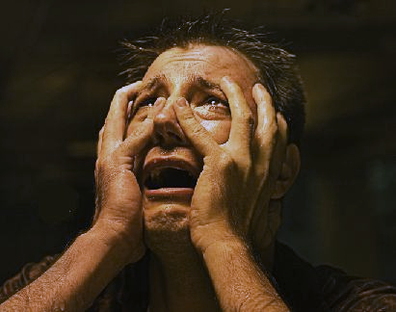
Calculating Limits
This is one of those moments
https://henrytrocino.files.wordpress.com/2013/08/weeping-and-gnashing-of-teeth-300x236.jpg

Slide 100

Calculating Limits
This is one of those moments
(There will be lots more…)
https://www.yourdictionary.com/images/main.shriek.jpg

Slide 101
Calculating Limits
Graphically, it
would look like:
https://www.mathsisfun.com/calculus/limits.html

Slide 102
Calculating Limits
Test both sides of the hole!
(we’ve already got the “coming up from the left” part)

Slide 103
Calculating Limits
Coming up from the left:
x | (x² − 1) (x − 1)
0.5 | 1.50000
0.9 | 1.90000
0.99 | 1.99000
0.999 | 1.99900
0.9999 | 1.99990
0.99999 | 1.99999
... | ..

Slide 104
Calculating Limits
Now we need the “going down from the right” part
(back to Excel)

Slide 105
Calculating Limits
Going down from the right:
x | (x² − 1) (x − 1)
1.5 | 2.50000
1.1 | 2.10000
1.01 | 2.01000
1.001 | 2.00100
1.0001 | 2.00010
1.00001 | 2.00001
... | ..

Slide 106
Calculating Limits
Since both sides give you the same answer, all is well!

Slide 107
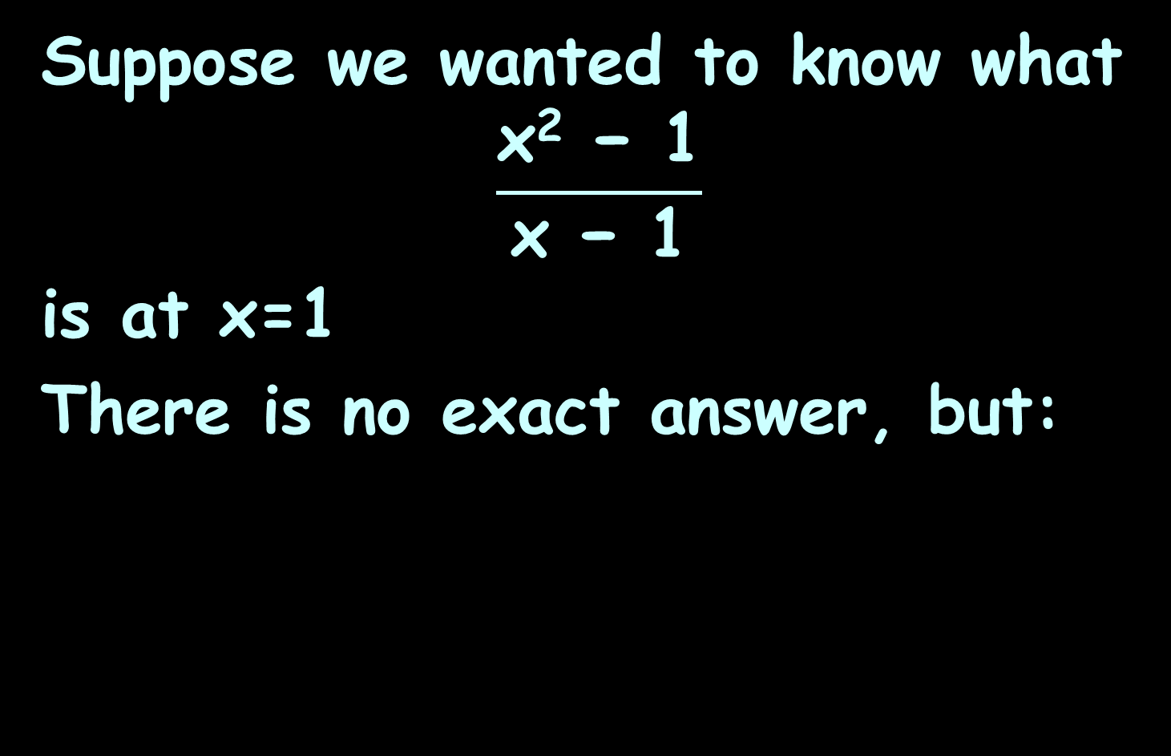
CALCULATING LIMITS
IN-CLASS PROBLEM 9
Suppose we wanted to know what
$$\frac{\text{x}\text{2}\text{ − 1}}{\text{x}\text{ − 1}}$$
is at x=1
There is no exact answer, but:
x²−1
x−1
lim
x→1
= 2

Slide 108
Questions?
http://i.imgur.com/aliTlT3.jpg

Slide 109
Calculating Limits
It is like running up a hill and then finding the path is magically "not there"...

Slide 110
Calculating Limits
It is like running up a hill and then finding the path is magically "not there"...
... but if we only check one side, who knows what happens?

Slide 111
Calculating Limits
It is like running up a hill and then finding the path is magically "not there"...
... but if we only check one side, who knows what happens?
So we need to test it from both directions to be sure where it "should be"!

Slide 112
Calculating Limits
Remember how I said it doesn’t always work?

Slide 113
CALCULATING LIMITS
IN-CLASS PROBLEM 10
What is the limit at x=5.5?
https://www.mathsisfun.com/calculus/limits.html

Slide 114
Calculating Limits
It’s not a hole… it’s a cliff!
https://www.mathsisfun.com/calculus/limits.html

Slide 115
Calculating Limits
The limit "does not exist“
“DNE”
https://www.mathsisfun.com/calculus/limits.html

Slide 116
Calculating Limits
We can't say what the value at 5.5 is, because there are two competing answers:
3.8 from the left, and
1.3 from the right
https://www.mathsisfun.com/calculus/limits.html

Slide 117
Calculating Limits
But we can define “one sided limits”:
the left-hand limit
is 3.8
the right-hand limit
is 1.3
the ordinary limit "does not exist"
https://www.mathsisfun.com/calculus/limits.html

Slide 118
CALCULATING LIMITS
IN-CLASS PROBLEM 10
This mess is written symbolically as:
but:
lim
x→5.5
Does not exist
LSL or LHL
lim
x→5.5⁻
= 3.8
RSL or RHL
lim
x→5.5⁺
= 1.3
https://www.mathsisfun.com/calculus/limits.html

Slide 119
CALCULATING LIMITS
IN-CLASS PROBLEM 11
What is the limit as x approaches 2?
https://www.mathsisfun.com/calculus/limits.html

Slide 120
CALCULATING LIMITS
IN-CLASS PROBLEM 11
What is the limit as x approaches 2? Does not exist
https://www.mathsisfun.com/calculus/limits.html

Slide 121
THE LIMIT DOES NOT EXIST

Slide 122
CALCULATING LIMITS
IN-CLASS PROBLEM 11
Are there right- and left-handed limits as x approaches 2? If so, what are they?
https://www.mathsisfun.com/calculus/limits.html

Slide 123
CALCULATING LIMITS
IN-CLASS PROBLEM 11
Are there right- and left-handed limits as x approaches 2? If so, what are they?
Lhl=2
Rhl=1
https://www.mathsisfun.com/calculus/limits.html

Slide 124
Questions?
http://i.imgur.com/aliTlT3.jpg

Slide 125
Continuity
A continuous process is one that takes place gradually, without interruption or abrupt change

Slide 126
Continuity
If a function is not continuous at a particular point, it is called “discontinuous” at that point
or that it has a “discontinuity” at that point

Slide 127
Continuity
continuous at “a”
discontinuous
at 1,3 and 5
https://coloradotech.vitalsource.com/#/books/9780357233375/cfi/6/20!/4/2372/4@0:76.0

Slide 128
Continuity
A continuous function ƒ has the property that a small change in x produces only a small change in ƒ(x)

Slide 129
Continuity
In fact, the change in ƒ(x) can be kept as small as we please by keeping the change in x sufficiently small

Slide 130
Continuity
Physical phenomena are usually continuous
For instance, the speed of a vehicle varies continuously with time
So does a person's height

Slide 131
Continuity
Some things are NOT continuous (tax tables for example)

Slide 132
Continuity
Discontinuities do occur in electric currents

Slide 133
Continuity
The Heaviside function H (named after the electrical engineer Oliver Heaviside (1850–1925)) is defined by
H(t)=
{
0 if t<0
1 if t≥0
https://en.wikipedia.org/wiki/Oliver_Heaviside#/media/File:Oheaviside.jpg

Slide 134
Continuity
(BTW – Heaviside is the one who brought complex numbers into circuit analysis – so if you don’t like the “j” – blame him!)
https://en.wikipedia.org/wiki/Oliver_Heaviside#/media/File:Oheaviside.jpg

Slide 135
Continuity
{
0 if t<0
1 if t≥0
H(t)=
This function is used to describe an electric current that is switched on at time
t = 0
https://en.wikipedia.org/wiki/Oliver_Heaviside#/media/File:Oheaviside.jpg

Slide 136
Continuity
{
0 if t<0
1 if t≥0
H(t)=
As t approaches 0 from the left, H(t) approaches 0
As t approaches 0
from the right
H(t) approaches 1
https://en.wikipedia.org/wiki/Oliver_Heaviside#/media/File:Oheaviside.jpg

Slide 137
Continuity
{
0 if t<0
1 if t≥0
H(t)=
There is no single number that H(t) approaches as t approaches 0
So does not exist
lim
t→0
https://en.wikipedia.org/wiki/Oliver_Heaviside#/media/File:Oheaviside.jpg

Slide 138
Continuity
{
0 if t<0
1 if t≥0
H(t)=
There is no single number that H(t) approaches as t approaches 0
H(t) = 0
H(t) = 1
lim
t→0⁻
lim
t→0⁺
https://en.wikipedia.org/wiki/Oliver_Heaviside#/media/File:Oheaviside.jpg

Slide 139
CONTINUITY
IN-CLASS PROBLEM 12
Where is the function discontinuous?
ƒ(x) =
{
1 .
x²
if x≠0
1 if x=0

Slide 140
CONTINUITY
IN-CLASS PROBLEM 12
Where is the function discontinuous? at x=0
ƒ(x) =
{
1 .
x²
if x≠0
1 if x=0

Slide 141

CONTINUITY
IN-CLASS PROBLEM 13
Where is the function discontinuous?
ƒ(x) = $\frac{\text{x}\text{2}\text{−}\text{x}\text{−2}}{\text{x}\text{−2}}$

Slide 142

CONTINUITY
IN-CLASS PROBLEM 13
Where is the function discontinuous? at x=2
ƒ(x) = $\frac{\text{x}\text{2}\text{−}\text{x}\text{−2}}{\text{x}\text{−2}}$

Slide 143
CONTINUITY
IN-CLASS PROBLEM 14
Where is the function discontinuous?
ƒ(x) = all integers

Slide 144
CONTINUITY
IN-CLASS PROBLEM 14
Where is the function discontinuous? at every integer
ƒ(x) = all integers

Slide 145
Continuity
A function can be continuous from the right
A function can be continuous from the left

Slide 146
Continuity
A function is continuous on an interval if it is continuous at every number in the interval

Slide 147
Questions?
http://i.imgur.com/aliTlT3.jpg

Slide 148

You Survived!
Today we studied:
Functions, transforming functions
Mathematical modeling
Limits, continuity
www.playbuzz.com

