Slide 1
Welcome to
Unit 3
Part 5!
MATH 207 Integral Calculus
http://en.wikipedia.org/wiki/Differential_equation#mediaviewer/File:Elmer-pump-heatequation.png

Slide 2
What’s Up?
Review:
Integration Techniques
New stuff:
Improper Integrals

Slide 3
What’s Up?
Outcome 4) Determine convergence or divergence of improper integrals using the comparison test and by direct computation.
Outcome 7) Solve problems by identifying the requirements, making a sketch as appropriate

Slide 4

Review
http://995642590.r.lightningbase-cdn.com/wp-content/uploads/2010/12/looking-back-hrexaminer-v144-cover425px.jpg

Slide 5
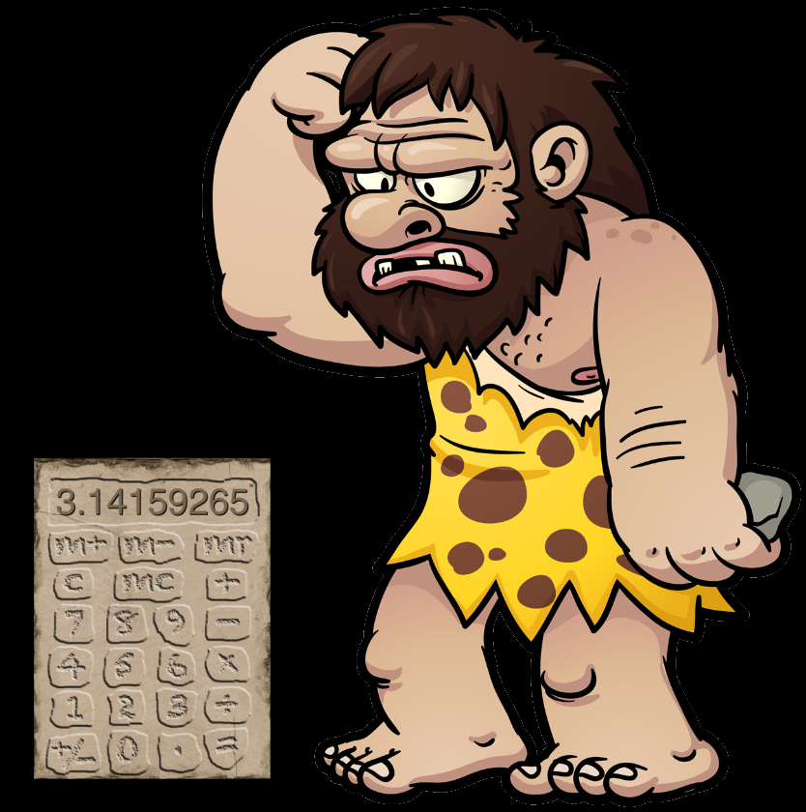
Integration Methods
Back in the stone age before fancy calculators
people came
up with a lot
of tricks to
help solve
NASTY
integrals
http://www.auburn.edu/academic/education/reading_genie/vowels/caveman.jpg
http://i.i.cbsi.com/cnwk.1d/i/tim/2010/10/01/fmimg63222559117213962_257x343.jpg

Slide 6
Integration Methods
We study them now to make you appreciate how nice your calculator is…

Slide 7
Tables of Integrals
Since people had trouble remembering all of the gazillions of integrals, tables were constructed as reminders

Slide 8



Tables of Integrals
Your problem:
Table entries:
Which would you use?
$$\int{\frac{dx}{(1−x^{2})}}$$
$$\int{\frac{dx}{(a−x^{2})}}$$
$$\int{\frac{dx}{(x^{2}−a)}}$$

Slide 9
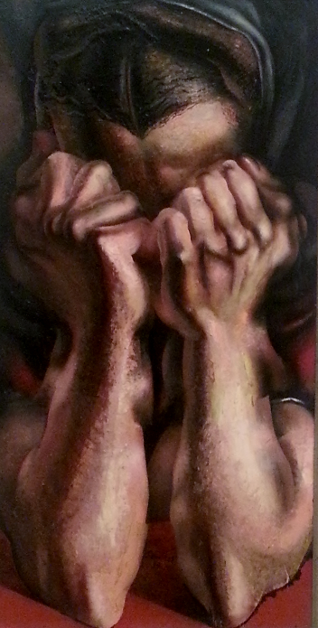
Tables of Integrals
Of course, whatever
problem you needed
to solve would not be
on the table…
http://mommyneedscoffee.com/wp-content/uploads/2012/09/TheSob.jpg

Slide 10
Tables of Integrals
For any given problem, the strategy was to rearrange and simplify your problem so it would look like something in the table

Slide 11

Tables of Integrals
Students really loved doing this
http://translationbiz.files.wordpress.com/2012/07/tearing-out-hair2.jpg

Slide 12
Integration by Parts
For nasty integrals containing multiplications you can sometimes use a technique called
Integration by Parts
This is just the product rule run backwards

Slide 13
Integration by Parts
Steps to perform integration by parts:
Given the integral:
∫ f(x) g(x) dx
1) Identify the two functions
being multiplied f(x) and g(x)

Slide 14
Integration by Parts
2) Make the function with the easiest antiderivative a derivative (g’(x) or f’(x)) and put it into the “dv" slot. The other becomes “u”:
u = f(x)
dv = g’(x) dx

Slide 15
Integration by Parts
3) Take the derivative of f(x)
and the integral of g’(x)dx
(ignore the +c) for:
du/dx = f'(x)
v = g(x)

Slide 16
Integration by Parts
4) Use the formula:
∫ u dv = (u×v) -∫ v du

Slide 17
Integration by Parts
BAD NEWS: Most of the time the integration by parts will not be enough to give you the answer after one shot
You may need to do some extra work: another integration by parts or some other technique (Like the fancy calculator…)

Slide 18

Trig Substitutions
These are used when an integral has a nasty divisor
in it:
$$\int{\frac{dx}{(1−x^{2})}}$$

Slide 19
Trig Substitutions
If the divisor of an integral contains a² − x²,
let x = a sin(θ)
and use the identity:
1 – sin²(θ) = cos²(θ)
http://en.wikipedia.org/wiki/Trigonometric_substitution

Slide 20
Trig Substitutions
If the divisor of an integral contains a² + x²,
let x = a tan(θ)
and use the identity:
1 + tan²(θ) = sec²(θ)

Slide 21
Trig Substitutions
If the divisor of an integral contains x² − a²,
let x = a sec(θ)
and use the identity:
sec²(θ) – 1 = tan²(θ)

Slide 22
Partial Fractions
Problems typically involve the splitting up of a single fraction into two or more fractions that each contain a single factor in the denominators

Slide 23
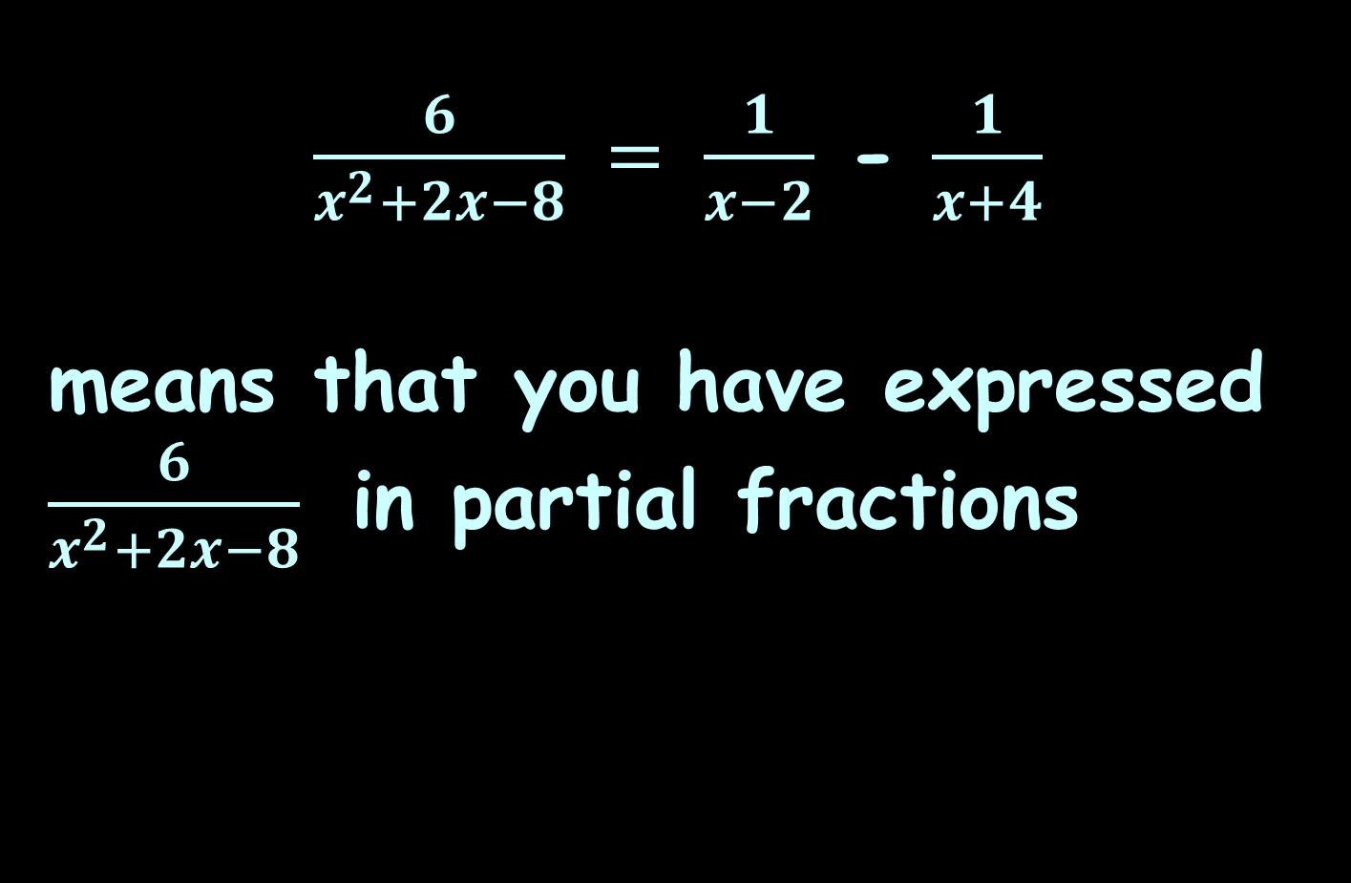
Partial Fractions
$\frac{6}{x^{2}+2x−8} = \frac{1}{x−2}$ - $\frac{1}{x+4}$
means that you have expressed $\frac{6}{x^{2}+2x−8}$ in partial fractions

Slide 24
Partial Fractions
Integration using partial fraction decomposition (abbreviated as PFD) is also known as partial fraction expansion (abbreviated as PFE)

Slide 25
Partial Fractions
Partial fraction decomposition (PFD) is the “undo” of combining rational functions over a common denominator

Slide 26
Integration Techniques
OK, so we’ve got a gazillion methods for doing integration
Does that mean that ANY function can be integrated?
That would be negatory…

Slide 27
Integration Techniques
No matter how hard we try, no matter the integration techniques we us
∫ e dt cannot be evaluated
t²

Slide 28
Integration Techniques
In fact, the majority of elementary functions do not have elementary antiderivatives

Slide 29
Numerical Methods
Numerical methods are used when a “close-enough” (statistical) answer is acceptable (like when there is no integration technique that will provide an answer)

Slide 30
Numerical Methods
The basic problem in numerical integration is to compute an approximate solution to a definite integral to a given degree of accuracy

Slide 31
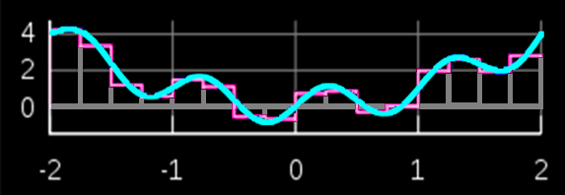
Numerical Methods
Techniques include rectangular interpolations
Rectangular interpolation
(The red shapes are estimating the area under the blue curve)
VFrench 2020

Slide 32

Numerical Methods
Techniques include trapezoidal interpolations
Trapezoidal interpolation
(The red shapes are estimating the area under the blue curve)
VFrench 2020

Slide 33
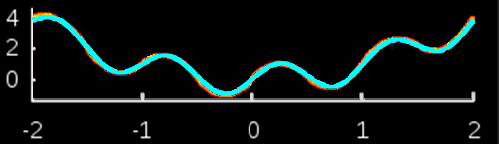
Numerical Methods
Simpson’s rule uses parabolas rather than straight lines – it is more complicated but more accurate
Simpson’s Rule
(The red shapes are estimating the area under the blue curve)

Slide 34
Numerical Methods
These approximations are the basis for many computer programs that estimate areas under curves

Slide 35

Questions?
http://i.imgur.com/aliTlT3.jpg

Slide 36
Area Under a Curve
The next few topics in this class will require you to remember how to do the “Area Under a Curve”

Slide 37
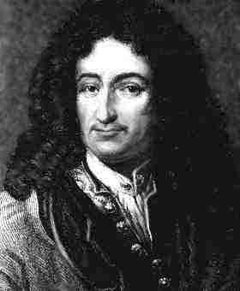
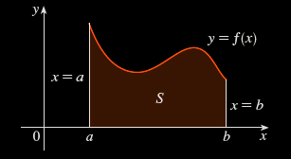
Area Under a Curve
Leibnitz was interested in solving the area problem: Calculate the area of the region that lies under
the curve
y = f(x) from a to b
https://coloradotech.vitalsource.com/#/books/9780357233375/cfi/6/28!/4/14@0:0
https://www.britannica.com/biography/Gottfried-Wilhelm-Leibniz

Slide 38
Area Under a Curve
What is an area?
The area of a rectangle is: lw
l
w
VFrench 2020

Slide 39
Area Under a Curve
What is an area?
The area of a triangle is: ½bh
h
b
VFrench 2020

Slide 40
Area Under a Curve
What is an area?
An area is easy to calculate for regions with straight sides

Slide 41
Area Under a Curve
What is an area?
It isn't so easy to calculate the area of a region with curved sides

Slide 42
Area Under a Curve
For a curve, you can draw rectangles (which you CAN calculate the area for) to sort of fit the curve
http://archives.math.utk.edu/visual.calculus/4/midpoint.1/integral.html

Slide 43
Area Under a Curve
You can build
rectangles
above the
curve, below
the curve,
or going
through
midpoints
Kalkulus_Integral__cover.png

Slide 44
Area Under a Curve
You know the
true area under
the curve is a
number between
the sum of the
blue rectangles
and the sum of
the tan
rectangles
VFrench 2020

Slide 45
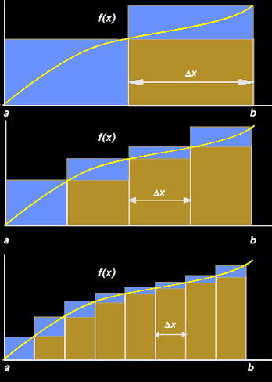
Area Under a Curve
As the rectangles
get narrower and
narrower (closer
and closer to
zero-width) the
area estimate
gets better
and better
VFrench 2020

Slide 46
Area Under a Curve
The true area is
going to be the
limit of the sum
of the blue and
tan rectangles (it
will converge)
VFrench 2020

Slide 47
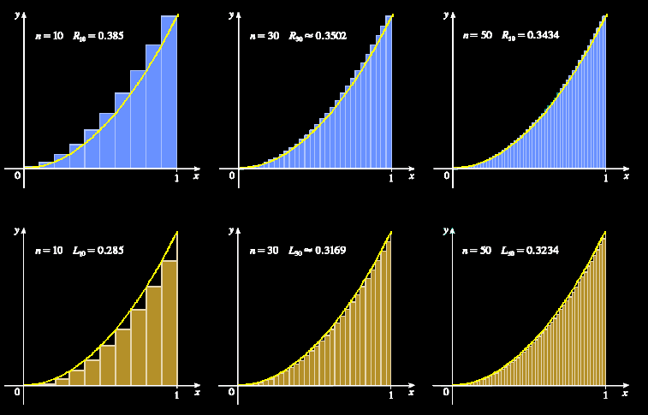
Area Under a Curve
https://coloradotech.vitalsource.com/#/books/9780357233375/cfi/6/28!/4/14@0:0

Slide 48
Area Under a Curve
This is what you are “adding up” that is the ∫um in integration – zillions of zero-width rectangles

Slide 49
Area Under a Curve
…and this is also why integral calculus is “nonsense”: you are adding up a whole bunch of zeros (areas of rectangles with zero width) to get something bigger than zero – the area under the curve

Slide 50
Area Under a Curve
…and this is also why integral calculus in “nonsense”: you are adding up a whole bunch of zeros (areas of rectangles with zero width) to get something bigger than zero – the area under the curve
Still, it works so well… let’s use it anyway!

Slide 51
Area Under a Curve
It’s also why this part of calculus is called “integration”: we are integrating all the slices together into a whole area

Slide 52
Area Under a Curve
This is the geometric interpretation of the integral (like tangent lines to the curve was the geometric interpretation of the derivative)

Slide 53
Area Under a Curve
The height of each rectangle is the value of the function at some point “t” along the base of the rectangle
{
ƒ (t)
t
VFrench 2020

Slide 54
Area Under a Curve
The width of each rectangle is a constant Δt
Δt
{
t
VFrench 2020

Slide 55
Area Under a Curve
The area of each rectangle is area = height x width = ƒ(t)Δt
Δt
{
{
ƒ (t)
t
VFrench 2020

Slide 56
Area Under a Curve
The area under the curve between a and b (“n” rectangles) is approximately equal to the sum:
S_{n} = ƒ(t₁)Δt + ƒ(t₂)Δt +…+ ƒ(t_{n})Δt
Δt
{
{
ƒ (t)
a
t
b
VFrench 2020

Slide 57
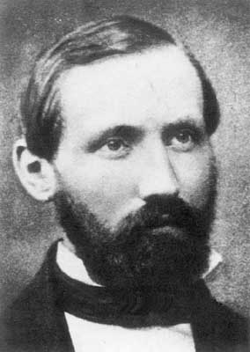
Area Under a Curve
S_{n} = ƒ(t₁)Δt + ƒ(t₂)Δt +…+ ƒ(t_{n})Δt
is called a “Riemann Sum”
Δt
{
{
ƒ (t)
Bernhard Riemann
a
t
b
https://www.usna.edu/Users/math/meh/riemann.html
VFrench 2020

Slide 58
Area Under a Curve
The smaller we choose the width Δx, the better the approximation for the area under the curve

Slide 59
Area Under a Curve
As Δx→0,
the number of terms n→∞
and the sum S_{n}→true area
under the curve:
S_{n} = A
lim
n→∞

Slide 60
Area Under a Curve
But, you wouldn’t want to actually do this to calculate the area under a curve

Slide 61
Area Under a Curve
But, you wouldn’t want to actually do this to calculate the area under a curve (it would take days to do even a simple problem)

Slide 62
Area Under a Curve
Instead, we use calculus:
A = ∫ƒ(b) dx - ∫ƒ(a) dx

Slide 63
Area Under a Curve
We write this symbolically as:
Where b is the upper limit and a the lower limit of the interval
∫ ƒ(x) dx
b
a

Slide 64
Area Under a Curve
The Fundamental Theorem of Calculus says if ƒ(x) is continuous on the interval a≤x≤b
then = F(b) – F(a)
where F’(x) = ƒ(x)
b
∫ ƒ(x) dx
a

Slide 65
Area Under a Curve
In other words, the technique for evaluating a definite integral is the same as calculating the area under the curve

Slide 66
Area Under a Curve
Another calculus theorem:
b
a
∫ ƒ(x) dx = -∫ ƒ(x) dx
a
b

Slide 67
Area Under a Curve
The units of the area under the curve are the units of the y axis times units of the x axis

Slide 68
Area Between Curves
These areas have a direction: it is the area UNDER the curve
= 0
1
∫ x dx
-1
VFrench 2020

Slide 69
Questions?
http://i.imgur.com/aliTlT3.jpg

Slide 70
Area Between Curves
The area under a curve is pretty easy if you know how to integrate the curve
https://www.math24.net/area-region-bounded-by-curves/

Slide 71
Area Between Curves
What if you wanted to know the area between two curves?
https://www.math24.net/area-region-bounded-by-curves/

Slide 72
Area Between Curves
Both curves have to be continuous over the interval
https://www.math24.net/area-region-bounded-by-curves/

Slide 73
Area Between Curves
The area between the curves is:
- =
∫ ƒ(x) – g(x) dx
b
a
ƒ(x)
g(x)
The area below the upper curve
The area below the lower curve
The area between the curves
https://www.math24.net/area-region-bounded-by-curves/

Slide 74
Area Between Curves
Another way to look at it: what height is each rectangle in the Riemann sum?
https://www.math24.net/area-region-bounded-by-curves/

Slide 75
Area Between Curves
Calculate the area between the curves on the interval -1,1
It’s not 0…
Area = 4
VFrench 2020

Slide 76
Area Between Curves
For the area UNDER a curve,
there is a required location
(between the
curve and the
x-axis) and
direction
(below the
curve)
https://www.wolframalpha.com/input/?i=definite+integral

Slide 77
Area Between Curves
This part is going
in the wrong
direction, so it’s
negative
Area = 0
https://www.wolframalpha.com/input/?i=definite+integral

Slide 78
Area Between Curves
The area between
curves, though,
doesn’t specify
which curve is
on top
You just calculate the area between the two curves
Area = 4
VFrench 2020

Slide 79
Area Under a Curve
Note: WolframAlpha does “area under a curve” as an absolute value and does NOT subtract the negative half from the positive half
(hence, their answers are wrong under the traditional rules)

Slide 80
Area Under a Curve
To get the right answer, use:
“definite integral” rather than “area under curve”

Slide 81
Questions?
http://i.imgur.com/aliTlT3.jpg

Slide 82
Improper Integrals
There are “proper” integrals and “improper” ones!
(We’ve been doing the “proper” ones”)

Slide 83
Improper Integrals
This is another example of mathematical terms giving a technique a bad name!
These integrals are not “improper” any more than complex numbers are “imaginary” or numbers like π are “irrational”

Slide 84
Improper Integrals
One type of “improper” integral has ∞ or -∞ for one or both of the limits

Slide 85
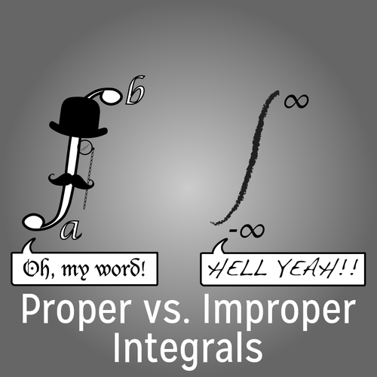
Improper Integrals
https://lifethroughamathematicianseyes.files.wordpress.com/2015/10/10570371_907996669229404_9017394763399384961_n.png

Slide 86
Improper Integrals
In general, we will replace the infinity with a variable (usually “b” or “a”), do the integral and then take the limit of the result as “b” or “a” goes to infinity

Slide 87
IMPROPER INTEGRALS
IN-CLASS PROBLEM 1
Evaluate: ∫₁∞ 1/x² dx
Sadly, we can’t just integrate as normal and then “plug in” infinity to get the answer – it’s a limit, not a number

Slide 88
IMPROPER INTEGRALS
IN-CLASS PROBLEM 1
Evaluate: ∫₁∞ 1/x² dx
Think of it as: What is the area under f(x)=1/x² on the
interval [1,∞)?
(Still not helpful to solve the problem!)

Slide 89
IMPROPER INTEGRALS
IN-CLASS PROBLEM 1
Evaluate: ∫₁∞ 1/x² dx
More helpful: What is the area under f(x)=1/b² on the
interval [1,t] if t is >1 and a finite real number?

Slide 90
IMPROPER INTEGRALS
IN-CLASS PROBLEM 1
Evaluate: ∫₁∞ 1/x² dx
More helpful - think of it as: What is the area under f(x)=1/b² on the
interval [1,b] if b is >1 and a finite real number?
OK! We can do that one!

Slide 91
IMPROPER INTEGRALS
IN-CLASS PROBLEM 1
Evaluate:
∫₁^{b} 1/x² dx = -1/x |₁^{b}
= -1/b - -1/1
= 1 – 1/b
Now we can calculate the area under this curve by taking the limit of 1-1/b as b→∞

Slide 92
IMPROPER INTEGRALS
IN-CLASS PROBLEM 1
Evaluate:
∫₁^{b} 1/x² dx = 1 – 1/b
lim(b→∞) (1-1/b) = 1-1/∞
= 1 - 0 = 1
So:
∫₁∞ 1/x² dx = lim(b→∞) (1-1/b)
= 1
The area under the curve is 1

Slide 93
Questions?
http://i.imgur.com/aliTlT3.jpg

Slide 94
Improper Integrals
Note: we might have expected the area under a curve on an infinite interval would be infinity…
But it’s actually not usually the case!

Slide 95
IMPROPER INTEGRALS
IN-CLASS PROBLEM 2
Evaluate: ∫₁∞ 1/x dx
What do we do?

Slide 96
IMPROPER INTEGRALS
IN-CLASS PROBLEM 2
Evaluate: ∫₁∞ 1/x dx
What do we do?
∫₁∞1/x dx = lim(b→∞)∫₁^{b}1/x) dx

Slide 97
IMPROPER INTEGRALS
IN-CLASS PROBLEM 2
Evaluate:
∫₁^{b} 1/x dx = ?

Slide 98
IMPROPER INTEGRALS
IN-CLASS PROBLEM 2
Evaluate:
∫₁^{b} 1/x dx = ln(x) |₁^{b}

Slide 99
IMPROPER INTEGRALS
IN-CLASS PROBLEM 2
Evaluate:
∫₁^{b} 1/x dx = ln(x) |₁^{b}
= ln(b) – ln(1)

Slide 100
IMPROPER INTEGRALS
IN-CLASS PROBLEM 2
Evaluate:
∫₁^{b} 1/x dx = ln(x) |₁^{b}
= ln(b) – ln(1)
= ln(b)
Now what?

Slide 101
IMPROPER INTEGRALS
IN-CLASS PROBLEM 2
Evaluate:
∫₁^{b} 1/x dx = ln(x) |₁^{b}
= ln(b) – ln(1)
= ln(b)
Now what?
lim(b→∞) ln(b) = ∞
So the area under the curve is ∞

Slide 102
Questions?
http://i.imgur.com/aliTlT3.jpg

Slide 103
Improper Integrals
Well, that was surprising! The area under 1/x² is 1 while the area under 1/x is infinite
1/x²
1/x
VFrench 2020

Slide 104
Improper Integrals
We call integrals convergent if the associated limit exists and is a finite number (it’s not plus or minus infinity) and divergent if the associated limit either doesn’t exist or is (plus or minus) infinity

Slide 105
Improper Integrals
So: 1/x² is convergent while 1/x is divergent

Slide 106
Improper Integrals
There are basically three cases:
1) ∫_{a}∞ƒ(x) dx infinity on the top
is convergent
2) ∫_{-∞}^{b}ƒ(x) dx negative infinity
on the bottom is convergent
3) Both ∫_{a}∞ƒ(x) dx and ∫_{-∞}^{b}ƒ(x) dx
are convergent

Slide 107
Improper Integrals
1) If ∫_{a}∞ ƒ(x) dx is convergent
∫_{a}∞ƒ(x) dx = lim(b→∞)∫_{a}^{b}ƒ(x) dx

Slide 108
Improper Integrals
2) If ∫_{-∞}^{b} ƒ(x) dx is convergent
∫_{-∞}^{b}ƒ(x) dx = lim(a→-∞)∫_{a}^{b}ƒ(x) dx

Slide 109
Improper Integrals
3) If both ∫_{a}∞ƒ(x) dx and
∫_{-∞}^{b} ƒ(x) dx are convergent
∫_{-∞}∞ ƒ(x) dx =
= ∫_{-∞}^{b} ƒ(x) dx + ∫_{a}∞ƒ(x) dx
= lim(b→∞)∫_{a}^{b}ƒ(x) dx
+ lim(a→-∞)∫_{a}^{b}ƒ(x) dx

Slide 110
IMPROPER INTEGRALS
IN-CLASS PROBLEM 3
Calculate: ∫_{-∞}∞ 1/(1+x²) dx
Which case is it?

Slide 111
IMPROPER INTEGRALS
IN-CLASS PROBLEM 3
Calculate: ∫_{-∞}∞ 1/(1+x²) dx
Which case is it? 3
∫_{-∞}∞ 1/(1+x²) dx =
= ∫_{-∞}^{b} 1/(1+x²) dx + ∫_{a}∞ 1/(1+x²) dx
= lim(b→∞)∫_{a}^{b} 1/(1+x²) dx
+ lim(a→-∞)∫_{a}^{b} 1/(1+x²) dx

Slide 112
IMPROPER INTEGRALS
IN-CLASS PROBLEM 3
Calculate: ∫_{-∞}∞ 1/(1+x²) dx
∫_{-∞}∞ 1/(1+x²) dx => ∫_{a}^{b} 1/(1+x²) dx
= ?

Slide 113
IMPROPER INTEGRALS
IN-CLASS PROBLEM 3
Calculate: ∫_{-∞}∞ 1/(1+x²) dx
∫_{-∞}∞ 1/(1+x²) dx => ∫_{a}^{b} 1/(1+x²) dx
= tan⁻¹(x) |_{a}^{b}
= tan⁻¹(b) - tan⁻¹(a)

Slide 114
IMPROPER INTEGRALS
IN-CLASS PROBLEM 3
Calculate: ∫_{-∞}∞ 1/(1+x²) dx
∫_{-∞}∞ 1/(1+x²) dx => ∫_{a}^{b} 1/(1+x²) dx
= tan⁻¹(x) |_{a}^{b}
= tan⁻¹(b) - tan⁻¹(a)
Now what?

Slide 115
IMPROPER INTEGRALS
IN-CLASS PROBLEM 3
Calculate: ∫_{-∞}∞ 1/(1+x²) dx
∫_{-∞}∞ 1/(1+x²) dx => ∫_{a}^{b} 1/(1+x²) dx
= tan⁻¹(x) |_{a}^{b}
= tan⁻¹(b) - tan⁻¹(a)
lim(b→∞) tan⁻¹(b) +
lim(a→-∞) -tan⁻¹(a)

Slide 116
IMPROPER INTEGRALS
IN-CLASS PROBLEM 3
Calculate: ∫_{-∞}∞ 1/(1+x²) dx
∫_{-∞}∞ 1/(1+x²) dx => ∫_{a}^{b} 1/(1+x²) dx
= tan⁻¹(x) |_{a}^{b}
= tan⁻¹(b) - tan⁻¹(a)
lim(b→∞) tan⁻¹(b) +
lim(a→-∞) -tan⁻¹(a)
= π/2 – (-π/2)
= π

Slide 117
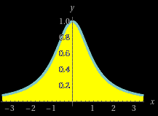
IMPROPER INTEGRALS
IN-CLASS PROBLEM 3
Calculate: ∫_{-∞}∞ 1/(1+x²) dx = π
So, the area under the entire curve from -∞ to ∞ is π
VFrench 2020

Slide 118
Questions?
http://i.imgur.com/aliTlT3.jpg

Slide 119
Improper Integrals
Another type of improper integral has non-infinite limits BUT is discontinuous in the interval

Slide 120

IMPROPER INTEGRALS
IN-CLASS PROBLEM 4
Calculate: ∫₂³ 1/$\sqrt{\text{x}\text{−2}}$ dx

Slide 121
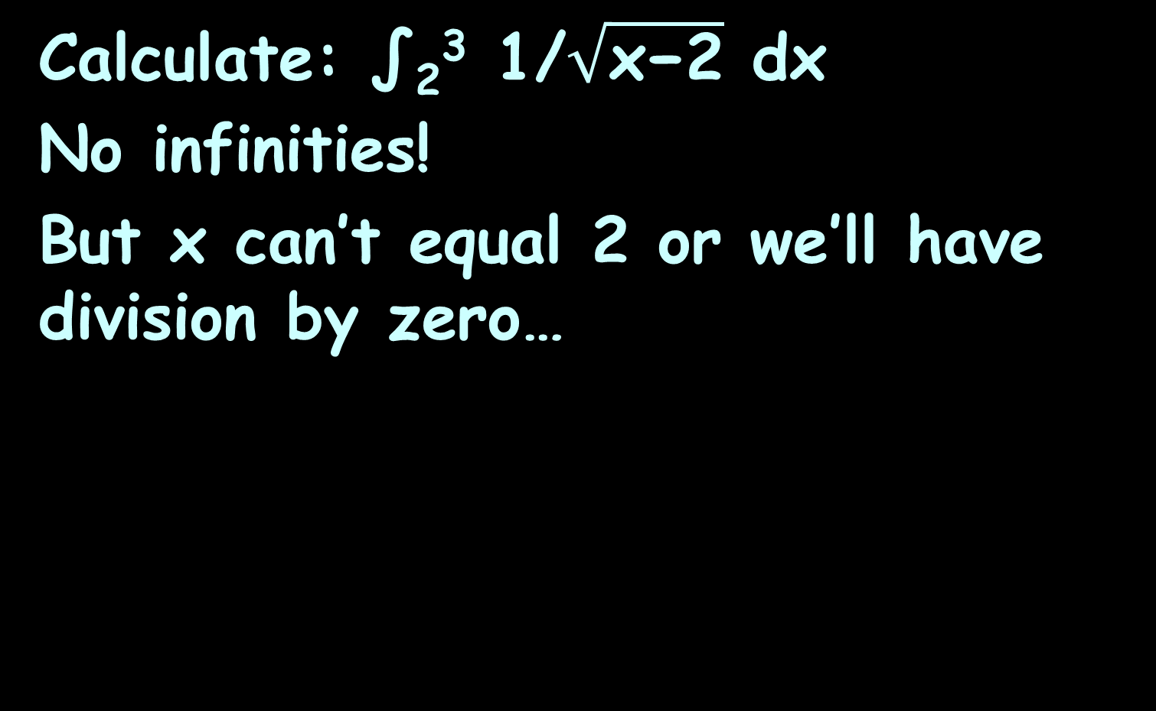
IMPROPER INTEGRALS
IN-CLASS PROBLEM 4
Calculate: ∫₂³ 1/$\sqrt{\text{x}\text{−2}}$ dx
No infinities!
But x can’t equal 2 or we’ll have division by zero…

Slide 122
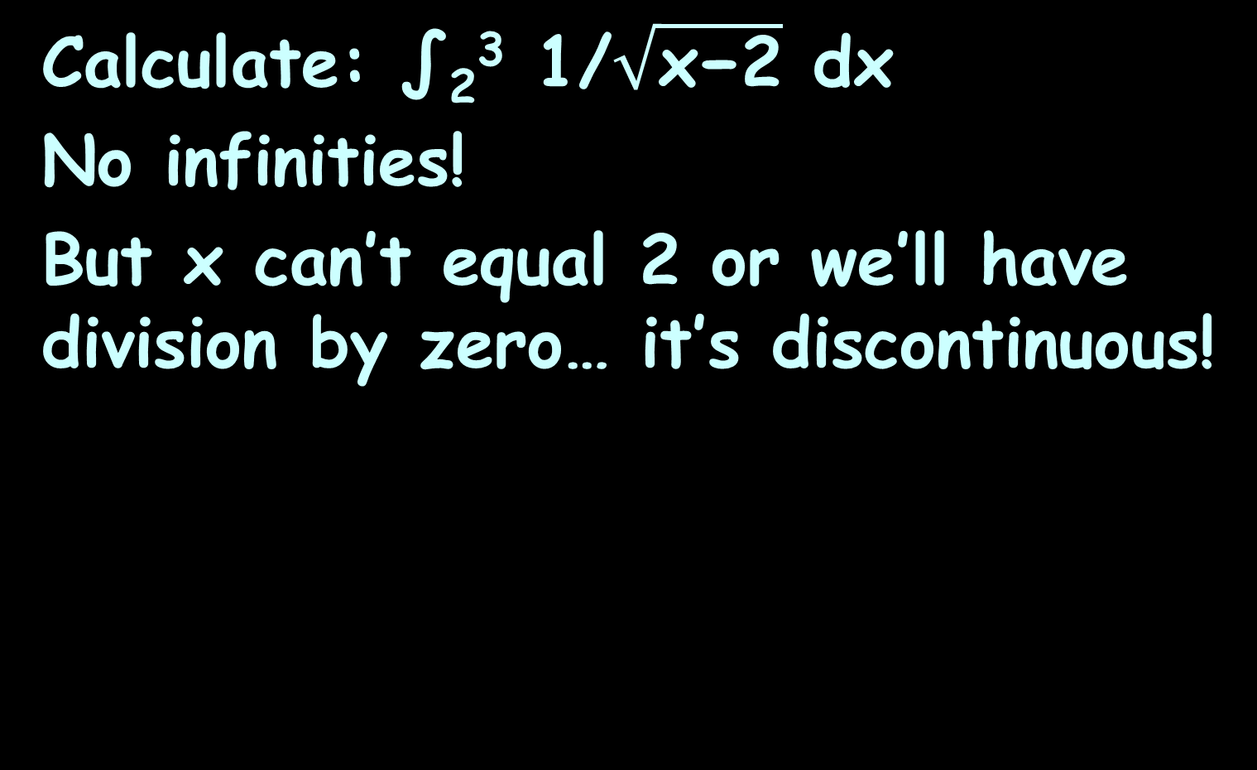
IMPROPER INTEGRALS
IN-CLASS PROBLEM 4
Calculate: ∫₂³ 1/$\sqrt{\text{x}\text{−2}}$ dx
No infinities!
But x can’t equal 2 or we’ll have division by zero… it’s discontinuous!

Slide 123
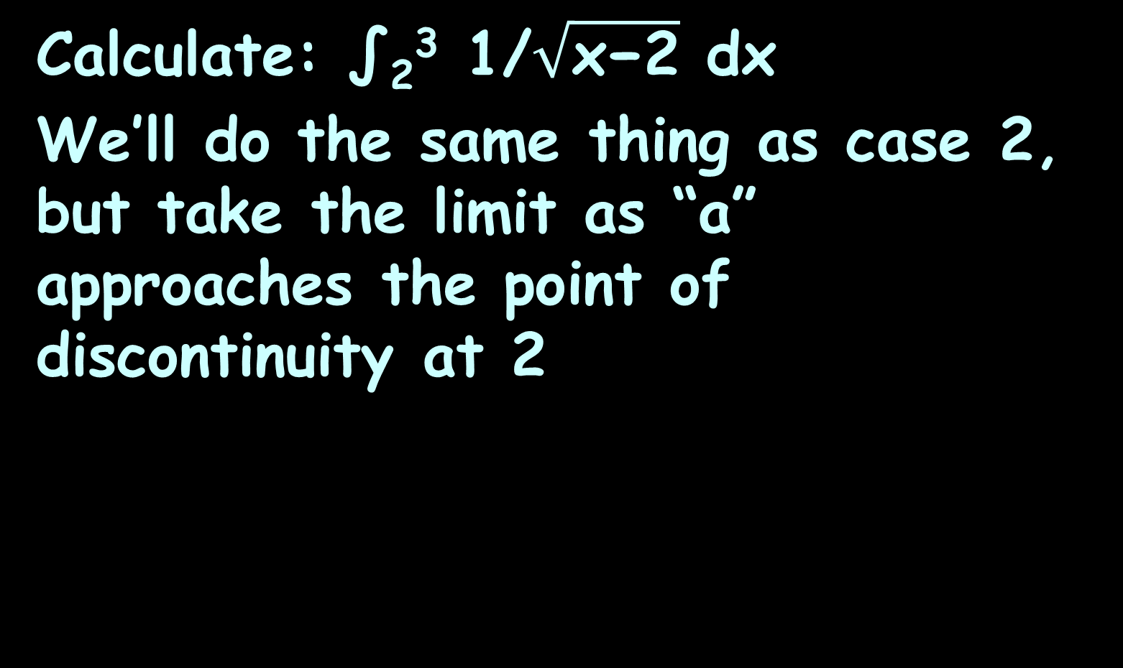
IMPROPER INTEGRALS
IN-CLASS PROBLEM 4
Calculate: ∫₂³ 1/$\sqrt{\text{x}\text{−2}}$ dx
We’ll do the same thing as case 2, but take the limit as “a” approaches the point of discontinuity at 2

Slide 124

IMPROPER INTEGRALS
IN-CLASS PROBLEM 4
Calculate: ∫₂³ 1/$\sqrt{\text{x}\text{−2}}$ dx
∫₂³ 1/$\sqrt{\text{x}\text{−2}}$dx => ∫_{a}³ 1/$\sqrt{\text{x}\text{−2}}$dx
= ?

Slide 125
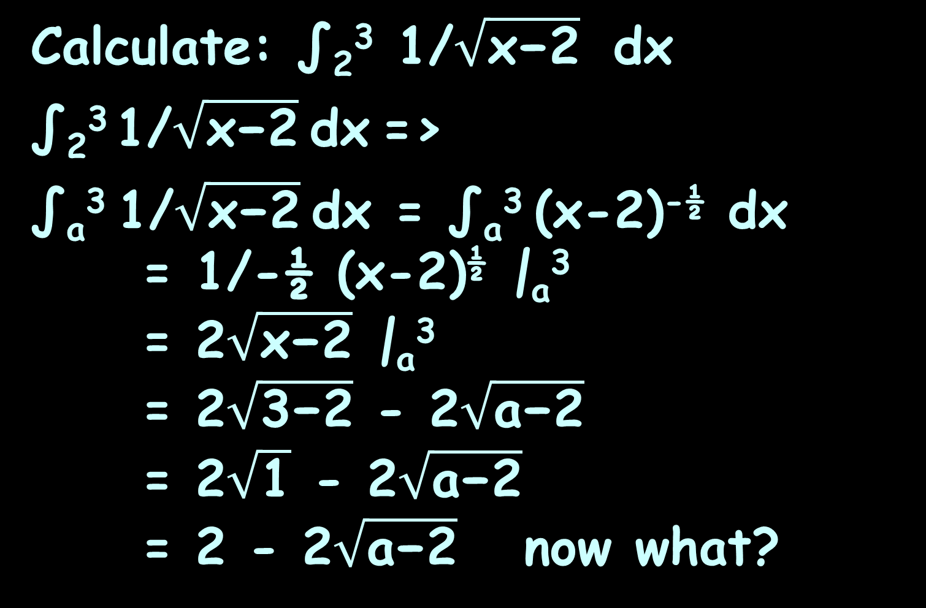
IMPROPER INTEGRALS
IN-CLASS PROBLEM 4
Calculate: ∫₂³ 1/$\sqrt{\text{x}\text{−2}}$ dx
∫₂³ 1/$\sqrt{\text{x}\text{−2}}$dx =>
∫_{a}³ 1/$\sqrt{\text{x}\text{−2}}$dx = ∫_{a}³ (x-2)^{-½} dx
= 1/-½ (x-2)^{½} |_{a}³
= 2$\sqrt{\text{x}\text{−2}}$ |_{a}³
= 2$\sqrt{\text{3}\text{−2}}$ - 2$\sqrt{\text{a}\text{−2}}$
= 2$\sqrt{\text{1}}$ - 2$\sqrt{\text{a}\text{−2}}$
= 2 - 2$\sqrt{\text{a}\text{−2}}$ now what?

Slide 126
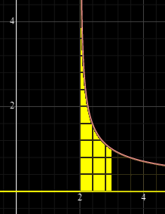

IMPROPER INTEGRALS
IN-CLASS PROBLEM 4
Calculate: ∫₂³ 1/$\sqrt{\text{x}\text{−2}}$ dx
∫₂³ 1/$\sqrt{\text{x}\text{−2}}$dx =
lim(a→2) (2 - 2$\sqrt{\text{a}\text{−2}})$ = 2-0 = 2
Each square is 0.16 sq units
VFrench 2023

Slide 127
Questions?
http://i.imgur.com/aliTlT3.jpg

Slide 128
IMPROPER INTEGRALS
IN-CLASS PROBLEM 5
A 1μF (0.00 000 1F) capacitor is initially charged to 1 volt. The capacitor’s stored charge can be modeled: q = Cv
= (1μF)(1v)
= 1 μcoulomb
t=0
+
(
1 volt
1μF
–
1M
A discharging capacitor
Oliver p207

Slide 129
IMPROPER INTEGRALS
IN-CLASS PROBLEM 5
q = Cv = (1μF)(1v) = 1 μcoulomb
When the switch is closed, the
1 μcoulomb of charge is sent to a resistor as a decaying current modeled by: i = i₀e^{-t/RC}
(using v=ir, i=v/r)
= (1v/1MΩ)e^{-t/1}
= 10⁻⁶e^{-t} amps
= e^{-t} μamps
t=0
+
(
1 volt
1μF
–
1M
A discharging capacitor
Oliver p207

Slide 130
IMPROPER INTEGRALS
IN-CLASS PROBLEM 5
i = e^{-t} μamps
After an
infinite amount
of time, the
capacitor will have discharged completely, and the current will drop to 0 amps
i (μamps)
t (sec)
Oliver p207
VFrench 2021

Slide 131
IMPROPER INTEGRALS
IN-CLASS PROBLEM 5
i = e^{-t} μamps
The charge q
delivered to the
resistor can be
calculated using the area under the curve
i (μamps)
t (sec)
Oliver p207
VFrench 2021

Slide 132
IMPROPER INTEGRALS
IN-CLASS PROBLEM 5
i = e^{-t} μamps
q = ∫ e^{-t} dt
Is it a proper
or an improper
integral?
i (μamps)
t (sec)
Oliver p207
VFrench 2021

Slide 133
IMPROPER INTEGRALS
IN-CLASS PROBLEM 5
i = e^{-t} μamps
q = ∫ e^{-t} dt
Is it a proper
or an improper
integral?
improper
What is the integral?
i (μamps)
t (sec)
Oliver p207
VFrench 2021

Slide 134

IMPROPER INTEGRALS
IN-CLASS PROBLEM 5
i = e^{-t} μamps
q = ∫ e^{-t} dt
What is the
integral?
q = ∫₀∞ e^{-t} dt
i (μamps)
t (sec)
!
Oliver p207
http://www.scienceteecher.com/images/D/just_du_it_calculus_shirt_white_large-01.jpg
VFrench 2021

Slide 135
IMPROPER INTEGRALS
IN-CLASS PROBLEM 5
i = e^{-t} μamps
q = ∫₀∞ e^{-t} dt
= ∫₀^{b} e^{-t} dt
= -e^{-t} |₀^{b}
= -e^{-b} - -e⁻⁰
= -e^{-b} + 1
Are we done?
i (μamps)
t (sec)
Oliver p207
VFrench 2021

Slide 136
IMPROPER INTEGRALS
IN-CLASS PROBLEM 5
i = e^{-t} μamps
q = ∫₀∞ e^{-t} dt
= -e^{-b} + 1
lim(b→∞) (-e^{-b} + 1) = 0 + 1
= 1 whats?
i (μamps)
t (sec)
Oliver p207
VFrench 2021

Slide 137
IMPROPER INTEGRALS
IN-CLASS PROBLEM 5
i = e^{-t} μamps
q = ∫₀∞ e^{-t} dt
= -e^{-b} + 1
lim(b→∞) (-e^{-b} + 1) = 0 + 1
= 1 μamps × sec
or
= 1 μcoulombs
because amps × sec = coulombs
i (μamps)
t (sec)
Oliver p207
VFrench 2021

Slide 138
Questions?
http://i.imgur.com/aliTlT3.jpg

Slide 139
Summary
Today we studied:
Review of Integration by
Parts and Partial Fraction Decomposition
Improper Integrals

Slide 140

You Survived!
www.playbuzz.com

