Slide 1
Welcome to
Unit 6
Part 12!
MATH 207 Integral Calculus
http://en.wikipedia.org/wiki/Differential_equation#mediaviewer/File:Elmer-pump-heatequation.png

Slide 2
What’s Up?
Review:
Sequences
New stuff:
Series

Slide 3
What’s Up?
Outcome 4) Determine convergence or divergence of improper integrals using the comparison test and by direct computation
Outcome 7) Solve problems by identifying the requirements, making a sketch as appropriate

Slide 4

Review
http://995642590.r.lightningbase-cdn.com/wp-content/uploads/2010/12/looking-back-hrexaminer-v144-cover425px.jpg

Slide 5
Sequences
Sequences are ordered lists

Slide 6

Sequences
They don’t have to be numbers

Slide 7
Sequences
Each member of a sequence is called a “term”

Slide 8
Sequences
Each term is designated by a subscript:
a_{1,} a_{2,} a_{3, ...,} a_{n, ...}
The 2nd term in the sequence
is a₂
The n^{th} term is a_{n}

Slide 9
Sequences
An infinite sequence goes on forever:
a_{1,} a_{2,} a_{3, ...}
A finite sequence stops at some point:
a_{1,} a_{2,} a_{3, ...,} a₁₂
ellipsis

Slide 10
Sequences
Numerical sequences are often formed by a formula that uses one term to calculate the next term in the sequence
You evaluate the sequence by plugging in the requested numbers for each term

Slide 11
Sequences
“Recursion formulas” - the formula calculates each term based on the previous term
Ex: a_{n} = a_{n-1} + k

Slide 12
Sequences
You have to be given a starting term (usually a₁) to evaluate these

Slide 13
Sequences
Remember, we said that a model that relies on the previous value to forecast the next value is called a “time series” model
Time series models are all recursion models

Slide 14
Sequences
note: sequences are discrete points, not a smooth function!

Slide 15
Arithmetic Sequences
Arithmetic Sequences:
Each term in the sequence (after the first) differs from the preceding by a constant amount (positive or negative)
start with a₁
increase each time by "d"

Slide 16
Arithmetic Sequences
The recursion formula for an arithmetic sequence is:
a_{n} = a_{n-1} + d
You can calculate any term in an arithmetic sequence using:
a_{n} = a₁+(n-1)d
“d” stands for “difference”

Slide 17
Geometric Sequences
Geometric Sequences:
Each term in the sequence (after the first) is a common
multiple (positive or negative) of the previous term

Slide 18
Geometric Sequences
The recursion formula for a geometric sequence is:
a_{n} = r × a_{n-1}
You can calculate any term in a geometric sequence using:
a_{n} = a₁r ^{n-1}
“r” stands for “ratio”

Slide 19

Questions?
http://i.imgur.com/aliTlT3.jpg

Slide 20
Sequences
Limit of a sequence
if the terms of a sequence approach a specific number, we say the limit of the sequence exists and it converges to the number

Slide 21
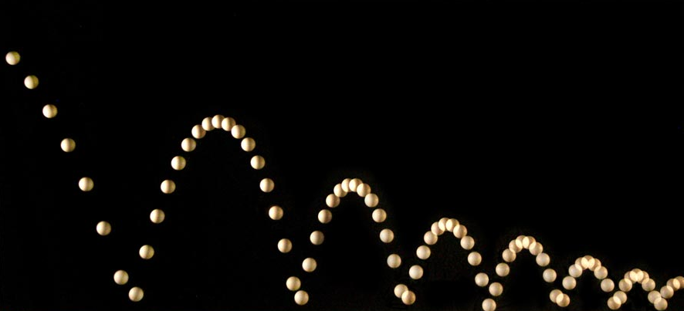
Sequences
Example: height of a bouncing ball
http://people.rit.edu/andpph/photofile-sci/bouncing-ball-7810.jpg

Slide 22
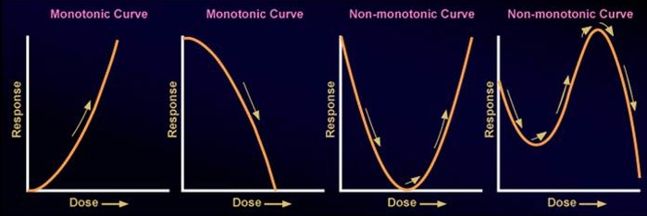
Sequences
Monotonic – either increasing or decreasing only
http://epa.gov/ncct/edr/images/nonmonotoniccurves2.jpg

Slide 23
Sequences
Non-decreasing – each term is greater than or equal to
the preceding term

Slide 24
Sequences
Non-increasing – each term is less than or equal to the preceding term

Slide 25
Sequences
Δƒ(x) ≥ 0 | Nondecreasing
Δƒ(x) ≤ 0 | Nonincreasing
Δƒ(x) > 0 | Increasing
Δƒ(x) < 0 | Decreasing
http://img.tfd.com/ggse/2c/gsed_0001_0016_0_img4169.png

Slide 26
Sequences
Bounded – all terms are less than or equal to some finite number in magnitude

Slide 27
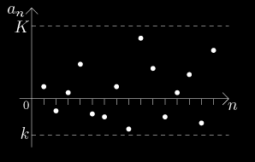
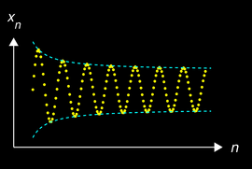
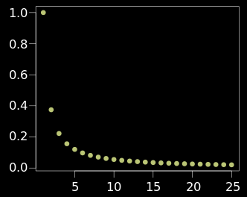
Sequences
http://math.feld.cvut.cz/mt/txta/1/gifa1/pc3aa1ba.gif
http://upload.wikimedia.org/wikipedia/commons/thumb/e/e4/Converging_Sequence_example.svg/320px-Converging_Sequence_example.svg.png
http://upload.wikimedia.org/wikipedia/commons/thumb/f/f4/Cauchy_sequence_illustration2.png/250px-Cauchy_sequence_illustration2.png

Slide 28
Sequences
Alternating Sequence:
Each term: (-1)^{n} a_{n}

Slide 29
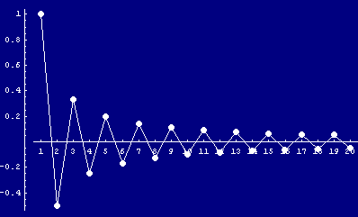
Sequences
5 -5 5 -5 5 -5 5 -5
http://www.cs.cas.cz/portal/AlgoMath/MathematicalAnalysis/InfiniteSeriesAndProducts/InfiniteSeries/SeriesWithArbitraryTerms/HTMLFiles/AlternatingSeries_38.gif

Slide 30
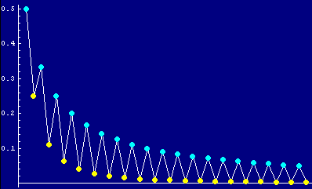
SEQUENCES
IN-CLASS PROBLEM 9
Is this an alternating sequence?
http://www.cs.cas.cz/portal/AlgoMath/MathematicalAnalysis/InfiniteSeriesAndProducts/InfiniteSeries/SeriesWithArbitraryTerms/HTMLFiles/AlternatingSeries_28.gif

Slide 31
SEQUENCES
IN-CLASS PROBLEM 9
Is this an alternating sequence?
yes, it is
http://www.cs.cas.cz/portal/AlgoMath/MathematicalAnalysis/InfiniteSeriesAndProducts/InfiniteSeries/SeriesWithArbitraryTerms/HTMLFiles/AlternatingSeries_28.gif

Slide 32
Questions?
http://i.imgur.com/aliTlT3.jpg

Slide 33
Sequences
Sequences can be a mixture of arithmetic and geometric

Slide 34
Sequences
Sequences can be a mixture of arithmetic and geometric
This is actually VERY common in the real world!

Slide 35
SEQUENCES
IN-CLASS PROBLEM 1a
A fishery manager knows that the fish population naturally increases at a rate of 1.5% per month. 80 fish are harvested each month. F₀ = 4000 fish. Let F_{n} be the fish population after the nth month.
Identify is this a geometric or an arithmetic sequence?

Slide 36
SEQUENCES
IN-CLASS PROBLEM 1a
A fishery manager knows that the fish population naturally increases at a rate of 1.5% per month. 80 fish are harvested each month. F₀ = 4000 fish. Let F_{n} be the fish population after the nth month.
Identify is this a geometric or an arithmetic sequence?
Geometric: * 1.5% each month
Arithmetic: -80 fish per month

Slide 37
SEQUENCES
IN-CLASS PROBLEM 1a
A fishery manager knows that the fish population naturally increases at a rate of 1.5% per month. 80 fish are harvested each month. F₀ = 4000 fish. Let F_{n} be the fish population after the nth month.
Identify is this a geometric or an arithmetic sequence? both

Slide 38
SEQUENCES
IN-CLASS PROBLEM 1b
A fishery manager knows that the fish population naturally increases at a rate of 1.5% per month. 80 fish are harvested each month. F₀ = 4000 fish. Let F_{n} be the fish population after the nth month.
Identify what is r?

Slide 39
SEQUENCES
IN-CLASS PROBLEM 1b
Rate = 1.5% = 0.015
But… if we multiply each recursive term by 0.015 the population will decrease each month!
Now what?

Slide 40
SEQUENCES
IN-CLASS PROBLEM 1c
Rate = 1.5% = 0.015
But… if we multiply each recursive term by 0.015 the population will decrease each month!
For r as a multiplier use
r = 1 + 0.015 = 1.015
That will give a 0.015 increase each month

Slide 41
SEQUENCES
IN-CLASS PROBLEM 1c
A fishery manager knows that the fish population naturally increases at a rate of 1.5% per month. 80 fish are harvested each month. F₀ = 4000 fish. Let F_{n} be the fish population after the nth month.
Identify what is d?

Slide 42
SEQUENCES
IN-CLASS PROBLEM 1c
A fishery manager knows that the fish population naturally increases at a rate of 1.5% per month. 80 fish are harvested each month. F₀ = 4000 fish. Let F_{n} be the fish population after the nth month.
Identify what is d? -80

Slide 43
SEQUENCES
IN-CLASS PROBLEM 1d
A fishery manager knows that the fish population naturally increases at a rate of 1.5% per month. 80 fish are harvested each month. F₀ = 4000 fish. Let F_{n} be the fish population after the nth month.
Identify what is F₀?

Slide 44
SEQUENCES
IN-CLASS PROBLEM 1d
A fishery manager knows that the fish population naturally increases at a rate of 1.5% per month. 80 fish are harvested each month. F₀ = 4000 fish. Let F_{n} be the fish population after the nth month.
Identify what is F₀? 4000

Slide 45
SEQUENCES
IN-CLASS PROBLEM 1e
r = 1.015
k = -80
F₀ = 4000
Find the fish population at the end of the fourth month F₄
Tempting, but wrong:
a_{n} = a₁+nd
a_{n} = r^{n}a₁
a_{n} = r^{n}a₁+nd

Slide 46
SEQUENCES
IN-CLASS PROBLEM 1e
The n^{th}-term model:
F_{n} = r(F_{n-1}) + d
F₁ = r(F₀)+d
F₂ = r(F₁)+d = r(rF₀+d)+d
= r²F₀+rd+d = r²F₀+(r+1)d
F₃ = r(F₂)+d
= r(r²F₀+(r+1)d)+d
= r³F₀+(r²+r+1)d

Slide 47
SEQUENCES
IN-CLASS PROBLEM 1e
The n^{th}-term model:
F_{n} = r(F_{n-1}) + d
F₁ = r(F₀)+d
F₂ = r²F₀+(r+1)d
F₃ = r³F₀+(r²+r+1)d
F₄ = r(r³F₀+(r²+r+1)d)+d
= r⁴F₀+(r³+r²+r)d+d
= r⁴F₀+(r³+r²+r+1)d
Are we done?

Slide 48
SEQUENCES
IN-CLASS PROBLEM 1e
The n^{th}-term model:
F_{n} = r(F_{n-1}) + d
F₁ = r(F₀)+d
F₂ = r²F₀+(r+1)d
F₃ = r³F₀+(r²+r+1)d
F₄ = r(r³F₀+(r²+r+1)d)+d
= r⁴F₀+(r³+r²+r)d+d
= r⁴F₀+(r³+r²+r+1)d
Whew! Yes!

Slide 49
SEQUENCES
IN-CLASS PROBLEM 1e
Our F₀ is the beginning of the first month
F₁ is the end of the first month
So F₄ is the end of the 4th month

Slide 50
SEQUENCES
IN-CLASS PROBLEM 1e
r = 1.015
d = -80
F₀ = 4000
F₄ = r⁴F₀+(r³+r²+r+1)d
Calculate the fish population at the end of the fourth month

Slide 51
SEQUENCES
IN-CLASS PROBLEM 1e
r = 1.015
d = -80
F₀ = 4000
F₄ = r⁴F₀+(r³+r²+r+1)d
Calculate the fish population at the end of the fourth month
F₄ = (1.015)⁴(4000)+((1.015)³+
(1.015)²+(1.015)+1)(-80)
≈ 3918.18 whats?

Slide 52
SEQUENCES
IN-CLASS PROBLEM 1e
r = 1.015
d = -80
F₀ = 4000
F₄ = r⁴F₀+(r³+r²+r+1)d
Calculate the fish population at the end of the fourth month
F₄ = (1.015)⁴(4000)+((1.015)³+
(1.015)²+(1.015)+1)(-80)
≈ 3918.18 fish but is it?

Slide 53
SEQUENCES
IN-CLASS PROBLEM 1e
r = 1.015
d = -80
F₀ = 4000
F₄ = r⁴F₀+(r³+r²+r+1)d
Calculate the fish population at the end of the fourth month
F₄ = (1.015)⁴(4000)+((1.015)³+
(1.015)²+(1.015)+1)(-80)
≈ 3918 fish
so is harvesting 80 fish per month too many?

Slide 54
SEQUENCES
IN-CLASS PROBLEM 1f
r = 1.015
Try: d = -79
F₀ = 4000
F₄ = r⁴F₀+(r³+r²+r+1)d
Calculate the fish population at the end of the fourth month
F₄ = (1.015)⁴(4000)+((1.015)³+
(1.015)²+(1.015)+1)(-79)
≈ 3922 fish not good enough!

Slide 55
SEQUENCES
IN-CLASS PROBLEM 1f
r = 1.015
Try: d = -60
F₀ = 4000
F₄ = r⁴F₀+(r³+r²+r+1)d
Calculate the fish population at the end of the fourth month
F₄ = (1.015)⁴(4000)+((1.015)³+
(1.015)²+(1.015)+1)(-60)
≈ 4000 fish if none die from natural causes!

Slide 56
Questions?
http://i.imgur.com/aliTlT3.jpg

Slide 57
Series
If you combine the numbers in a sequence into a single number, it’s called a “series”

Slide 58
Series
This is usually done by adding up all of the terms or multiplying all of them together

Slide 59
SERIES
IN-CLASS PROBLEM 2
What is the sum of the first 10 counting numbers?

Slide 60
SERIES
IN-CLASS PROBLEM 2
What is the sum of the first 10 counting numbers?
1+2+3+4+5+6+7+8+9+10

Slide 61
SERIES
IN-CLASS PROBLEM 2
Here’s a trick:
1 + 10 = 11
2 + 9 = 11
3 + 8 = 11
4 + 7 = 11
5 + 6 = 11
So the answer is 5 × 11 = 55

Slide 62
Series
It’s math class… so there’s always a new symbol!
∑
means “add ‘em up!”

Slide 63
Series
If you want to multiply them all together rather than adding them:
Π
means “multiply ‘em up!”

Slide 64
Series
We could have written:
What is the sum of the first 10 counting numbers?
as:
∑ 1 2 3…10

Slide 65
Series
We usually use ∑ with a formula:
This means “add up the n’s where n goes from 1 to 10”
10
∑ n
n=1

Slide 66
SERIES
IN-CLASS PROBLEM 3a
4
Calculate the series ∑ (n + 1)
n=1

Slide 67
SERIES
IN-CLASS PROBLEM 3a
4
Calculate the series ∑ (n + 1)
n=1
Just start adding up the (n + 1)s
Plugging in n=1, n=2, n=3, n=4

Slide 68
SERIES
IN-CLASS PROBLEM 3a
4
Calculate the series ∑ (n + 1)
n=1
= 1 + 1
+ 2 + 1
+ 3 + 1
+ 4 + 1
= 2 + 3 + 4 + 5 = ?

Slide 69
SERIES
IN-CLASS PROBLEM 3a
4
Calculate the series ∑ (n + 1)
n=1
= 1 + 1
+ 2 + 1
+ 3 + 1
+ 4 + 1
= 2 + 3 + 4 + 5 = 14

Slide 70
SERIES
IN-CLASS PROBLEM 3b
Calculate:
3
∑ (2n)
n=1
3
∑ (3n+2)
n=1
4
∑ (n²)
n=2

Slide 71
SERIES
IN-CLASS PROBLEM 3b
Calculate:
= 2(1)+2(2)+2(3) = 12
3
∑ (2n)
n=1
3
∑ (3n+2)
n=1
4
∑ (n²)
n=2

Slide 72
SERIES
IN-CLASS PROBLEM 3b
Calculate:
= 2(1)+2(2)+2(3) = 12
= 3(1)+2 + 3(2)+2 + 3(3)+2 = 24
3
∑ (2n)
n=1
3
∑ (3n+2)
n=1
4
∑ (n²)
n=2

Slide 73
SERIES
IN-CLASS PROBLEM 3b
Calculate:
= 2(1)+2(2)+2(3) = 12
= 3(1)+2 + 3(2)+2 + 3(3)+2 = 24
= 2²+3²+4² = 29
3
∑ (2n)
n=1
3
∑ (3n+2)
n=1
4
∑ (n²)
n=2

Slide 74
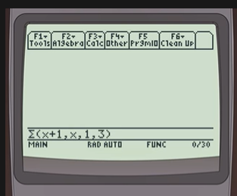
Series
On the TI89:
F3 (Calc)
4: ∑

Slide 75
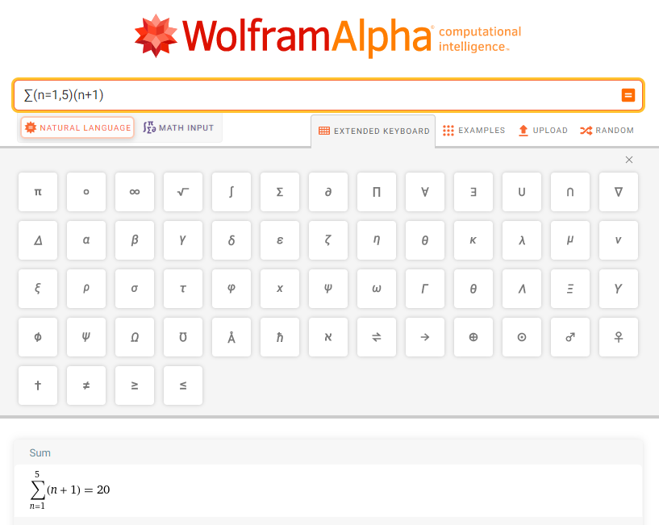

Slide 76
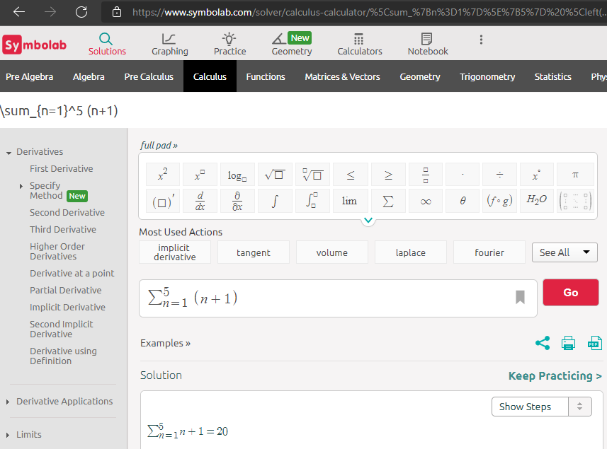

Slide 77
TI84
Math
0 or scroll to:
Summation ∑(

Slide 78
Questions?
http://i.imgur.com/aliTlT3.jpg

Slide 79
Series
The sum of the first n terms of an arithmetic sequence is:
n n
S_{n} = ∑ a_{k} = ∑ (a₁+(k-1)d)
k=1 k=1
= (n/2) (2a₁+(n – 1) d)

Slide 80
SERIES
IN-CLASS PROBLEM 4a
Calculate the sum of the first
12 terms in the sequence:
1 4 7 10 13…
Is it an arithmetic sequence?

Slide 81
SERIES
IN-CLASS PROBLEM 4a
Calculate the sum of the first
12 terms in the sequence:
1 4 7 10 13…
Is it an arithmetic sequence?
Yep!
S_{n} = (n/2) (2a₁+(n – 1) d)

Slide 82
SERIES
IN-CLASS PROBLEM 4a
Calculate the sum of the first
12 terms in the sequence:
1 4 7 10 13…
What is a₁?
What is d?
What is n?
S_{n} = (n/2) (2a₁+(n – 1) d)

Slide 83
SERIES
IN-CLASS PROBLEM 4a
Calculate the sum of the first
12 terms in the sequence:
1 4 7 10 13…
What is a₁? 1
What is d?
What is n?
S_{n} = (n/2) (2a₁+(n – 1) d)

Slide 84
SERIES
IN-CLASS PROBLEM 4a
Calculate the sum of the first
12 terms in the sequence:
1 4 7 10 13…
What is a₁? 1
What is d? 3
What is n?
S_{n} = (n/2) (2a₁+(n – 1) d)

Slide 85
SERIES
IN-CLASS PROBLEM 4a
Calculate the sum of the first
12 terms in the sequence:
1 4 7 10 13…
What is a₁? 1
What is d? 3
What is n? 12
What is the sum S_{n}?
S_{n} = (n/2) (2a₁+(n – 1) d)

Slide 86
SERIES
IN-CLASS PROBLEM 4a
Calculate the sum of the first
12 terms in the sequence:
1 4 7 10 13…
What is a₁? 1
What is d? 3
What is n? 12
What is the sum S_{n}?
(12/2) (2(1)+(12–1)(3)) = 210
S_{n} = (n/2) (2a₁+(n – 1) d)

Slide 87
Questions?
http://i.imgur.com/aliTlT3.jpg

Slide 88
Series
The sum of the first n terms of a geometric sequence is given by
n
S_{n} = ∑ a₁r^{k} = a₁ (1-r^{n+1})/(1-r)
k=1

Slide 89
SERIES
IN-CLASS PROBLEM 4b
Calculate the sum of the first
12 terms in the sequence:
2 6 18 54 162…
Is it geometric?

Slide 90
SERIES
IN-CLASS PROBLEM 4b
Calculate the sum of the first
12 terms in the sequence:
2 6 18 54 162…
Is it geometric?
Yep!
S_{n} = a₁ (1-r^{n+1})/(1-r)

Slide 91
SERIES
IN-CLASS PROBLEM 4b
Calculate the sum of the first
12 terms in the sequence:
2 6 18 54 162…
What is a₁?
What is r?
What is n?
S_{n} = a₁ (1-r^{n+1})/(1-r)

Slide 92
SERIES
IN-CLASS PROBLEM 4b
Calculate the sum of the first
12 terms in the sequence:
2 6 18 54 162…
What is a₁? 2
What is r?
What is n?
S_{n} = a₁ (1-r^{n+1})/(1-r)

Slide 93
SERIES
IN-CLASS PROBLEM 4b
Calculate the sum of the first
12 terms in the sequence:
2 6 18 54 162…
What is a₁? 2
What is r? 3
What is n?
S_{n} = a₁ (1-r^{n+1})/(1-r)

Slide 94
SERIES
IN-CLASS PROBLEM 4b
Calculate the sum of the first
12 terms in the sequence:
2 6 18 54 162…
What is a₁? 2
What is r? 3
What is n? 12
What is the sum S_{n}?
S_{n} = a₁ (1-r^{n+1})/(1-r)

Slide 95
SERIES
IN-CLASS PROBLEM 4b
Calculate the sum of the first
12 terms in the sequence:
2 6 18 54 162…
What is a₁? 2
What is r? 3
What is n? 12
What is the sum S_{n}?
(2) (1-3¹²⁺¹)/(1-3) = 1,594,322
S_{n} = a₁ (1-r^{n+1})/(1-r)

Slide 96
Series
You definitely would not want to do that one by hand!

Slide 97
Series
How can you tell if a series is arithmetic or geometric?

Slide 98
Series
How can you tell if a series is arithmetic or geometric?
Check arithmetic first – is the difference between adjacent terms a constant

Slide 99
Series
How can you tell if a series is arithmetic or geometric?
Geometric goes up fast
But a fast-increasing series might be exponential rather than geometric

Slide 100
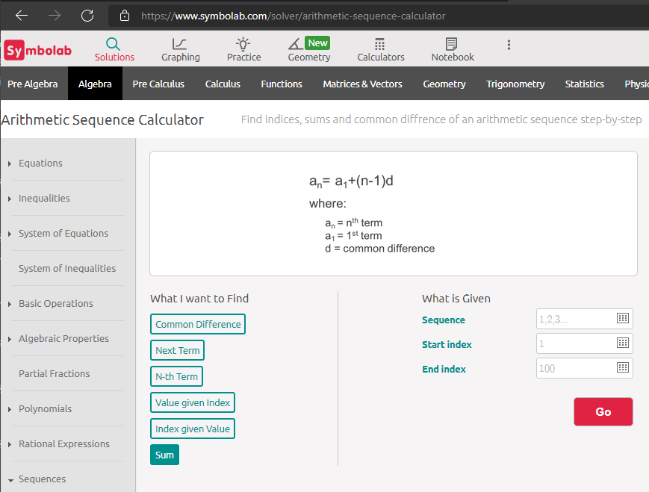

Slide 101
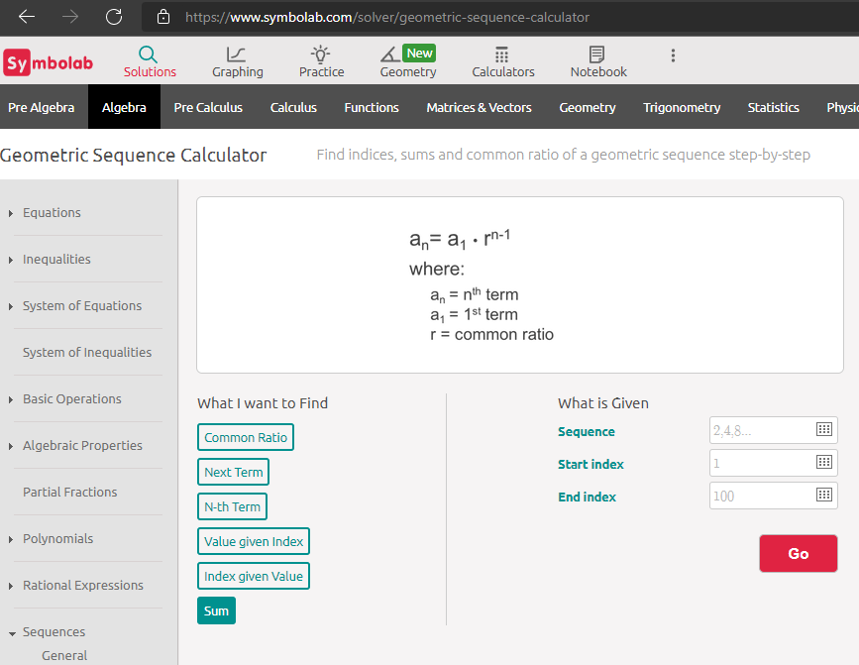

Slide 102
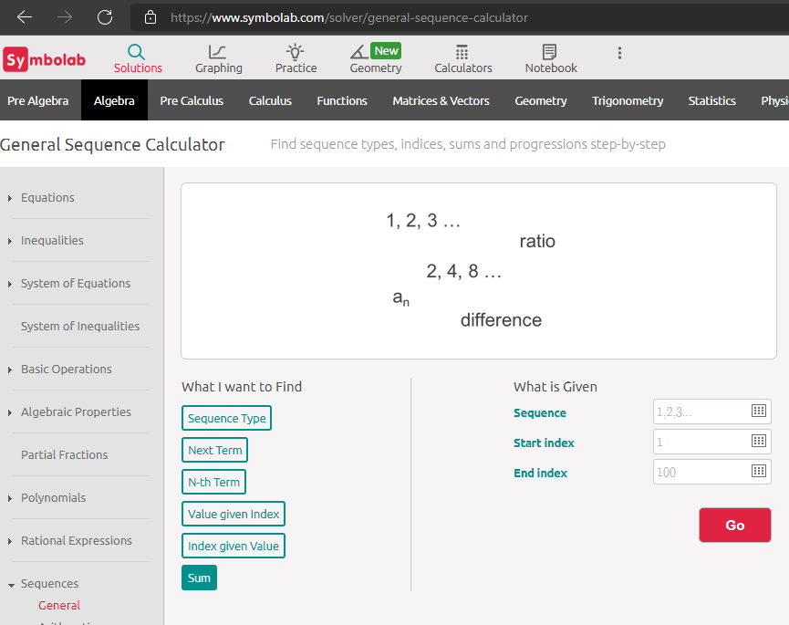

Slide 103
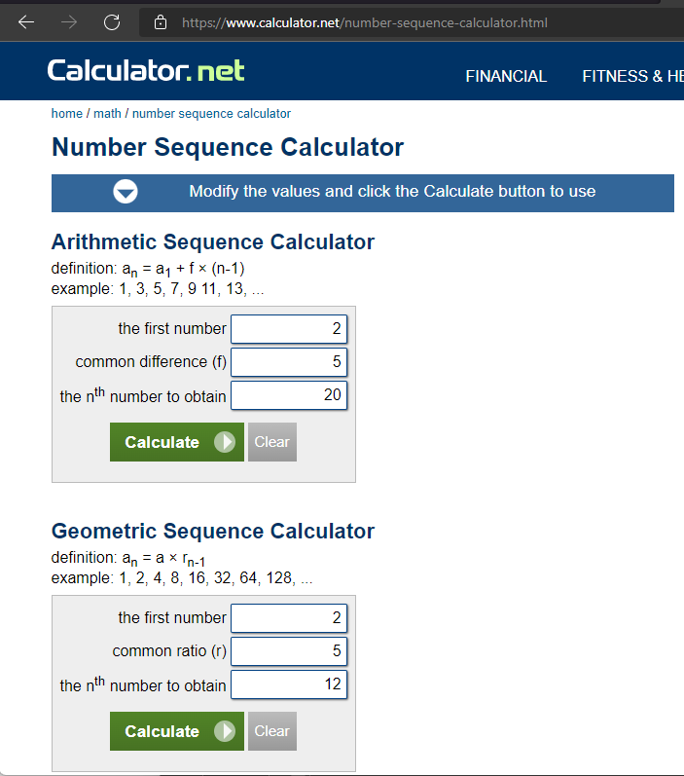

Slide 104
Questions?
http://i.imgur.com/aliTlT3.jpg

Slide 105
Series
Infinite series vs partial sum

Slide 106
Series
Given a sequence of numbers {a_{n}}, the sum of the terms of this sequence:
a₁ + a₂ + a₃ + ... + a_{n} + ...
is called an infinite series

Slide 107
Series
The sequence S_{n} defined by
S₁ = a₁
S₂ = a₁ + a₂
S_{n} = a₁ + a₂ + a₃ + ... + a_{n}
n
= ∑ a_{k}
k=1
is the sequence of partial sums of the series

Slide 108
Series
The number S_{n} is the nth partial sum

Slide 109
SERIES
IN-CLASS PROBLEM 5
Is it a partial sum or an infinite series?
S_{n} = a₁ + a₂ + a₃ + ... + a_{n}
S_{n} = a₁ + a₂ + a₃ + ...

Slide 110
SERIES
IN-CLASS PROBLEM 5
Is it a partial sum or an infinite series?
S_{n} = a₁ + a₂ + a₃ + ... + a_{n}
partial sum
S_{n} = a₁ + a₂ + a₃ + ...

Slide 111
SERIES
IN-CLASS PROBLEM 5
Is it a partial sum or an infinite series?
S_{n} = a₁ + a₂ + a₃ + ... + a_{n}
partial sum
S_{n} = a₁ + a₂ + a₃ + ...
infinite series

Slide 112
Questions?
http://i.imgur.com/aliTlT3.jpg

Slide 113
Series
All of the series we have investigated so far have been summation series

Slide 114
Series
Multiplication series are not as common, but there is one that is critical in many calculations

Slide 115
Series
Factorial notation
n! = n(n-1)(n-2)...3 × 2 × 1
(More new symbols)

Slide 116
Series
So, 4! would be:
4 × (4-1) × (4-2) × (4-3)
Don’t go to 4-4 (that would be zero…)
4! = 4 × 3 × 2 × 1 = ?

Slide 117
Series
So, 4! would be:
4 × (4-1) × (4-2) × (4-3)
Don’t go to 4-4 (that would be zero…)
4! = 4 × 3 × 2 × 1 = 24

Slide 118
TI84
Math
Prob
4th one down 4)
!

Slide 119
TI89
2nd 5 (Math)
7: Probability
1: !

Slide 120
SERIES
IN-CLASS PROBLEM 6
Calculate 5! ?
Calculate 9! ?
Calculate 9!/5! ?

Slide 121
SERIES
IN-CLASS PROBLEM 6
Calculate 5! ? 120
Calculate 9! ?
Calculate 9!/5! ?

Slide 122
SERIES
IN-CLASS PROBLEM 6
Calculate 5! ? 120
Calculate 9! ? 362,880
Calculate 9!/5! ?

Slide 123
SERIES
IN-CLASS PROBLEM 6
Calculate 5! ? 120
Calculate 9! ? 362,880
Calculate 9!/5! ? 3024

Slide 124
SERIES
IN-CLASS PROBLEM 6
Calculate 9!/5! = 3024
9*8*7*6*5*4*3*2*1
5*4*3*2*1
9!/5! =

Slide 125
SERIES
IN-CLASS PROBLEM 6
Calculate 9!/5! = 3024
9*8*7*6*5*4*3*2*1
5*4*3*2*1
9!/5! =

Slide 126
SERIES
IN-CLASS PROBLEM 6
Calculate 9!/5! = 3024
9*8*7*6*5*4*3*2*1
5*4*3*2*1
9!/5! =

Slide 127
SERIES
IN-CLASS PROBLEM 6
Calculate 9!/5! = 3024
9*8*7*6*5*4*3*2*1
5*4*3*2*1
9!/5! =

Slide 128
SERIES
IN-CLASS PROBLEM 6
Calculate 9!/5! = 3024
9*8*7*6*5*4*3*2*1
5*4*3*2*1
9!/5! =

Slide 129
SERIES
IN-CLASS PROBLEM 6
Calculate 9!/5! = 3024
9*8*7*6*5*4*3*2*1
5*4*3*2*1
9!/5! =

Slide 130
SERIES
IN-CLASS PROBLEM 6
Calculate 9!/5! = 3024
9*8*7*6*5*4*3*2*1
5*4*3*2*1
= 9*8*7*6
9!/5! =

Slide 131
SERIES
IN-CLASS PROBLEM 6
Calculate 9!/5! = 3024
9*8*7*6*5*4*3*2*1
5*4*3*2*1
= 9*8*7*6 = 3024
9!/5! =

Slide 132
Questions?
http://i.imgur.com/aliTlT3.jpg

Slide 133
Series
Factorials are used a LOT in what are called “counting” problems

Slide 134
COUNTING
IN-CLASS PROBLEM 7a
A safe code has four numbers
The first number can be any number between 1-9
The second can be any number 1-9 not used as the first number
The third can be any number 1-9 not used as the first two numbers
The fourth can be any number 1-9 not used as the first three numbers
How many codes are there?

Slide 135
COUNTING
IN-CLASS PROBLEM 7a
Calculate how many codes are there?
. . . .
The first number can be any number between 1-9

Slide 136
COUNTING
IN-CLASS PROBLEM 7a
Calculate how many codes are there?
9 . . . .
The first number can be any number between 1-9
The second can be any number 1-9 not used as the first number

Slide 137
COUNTING
IN-CLASS PROBLEM 7a
Calculate how many codes are there?
9 . 8 . . .
The first number can be any number between 1-9
The second can be any number 1-9 not used as the first number
The third can be any number 1-9 not used as the first two numbers

Slide 138
COUNTING
IN-CLASS PROBLEM 7a
Calculate how many codes are there?
9 . 8 . 7 . .
The first number can be any number between 1-9
The second can be any number 1-9 not used as the first number
The third can be any number 1-9 not used as the first two numbers
The fourth can be any number 1-9 not used as the first three numbers

Slide 139
COUNTING
IN-CLASS PROBLEM 7a
Calculate how many codes are there?
9 . 8 . 7 . 6 .
The first number can be any number between 1-9
The second can be any number 1-9 not used as the first number
The third can be any number 1-9 not used as the first two numbers
The fourth can be any number 1-9 not used as the first three numbers

Slide 140
COUNTING
IN-CLASS PROBLEM 7a
Calculate how many codes are there?
9 . 8 . 7 . 6 .
So how many codes? Hmm…

Slide 141
COUNTING
IN-CLASS PROBLEM 7a
Calculate how many codes are there?
9 . 1 . 7 . 6 .
Well, if we only had two slots and there were nine possibilities in the first slot and only 1 in the second, there would be 9 codes

Slide 142
COUNTING
IN-CLASS PROBLEM 7a
Calculate how many codes are there?
9 . 2 . 7 . 6 .
If we only had two slots and there were nine possibilities in the first slot and only 2 in the second, there would be 9+9 or
18 codes

Slide 143
COUNTING
IN-CLASS PROBLEM 7a
Calculate how many codes are there?
9 . 2 . 7 . 6 .
So, we are obviously multiplying the numbers in each slot to find the total number of codes

Slide 144
COUNTING
IN-CLASS PROBLEM 7a
Calculate how many codes are there?
9 . 8 . 7 . 6 .
Total number of codes =
= 9 × 8 × 7 × 6 = 3024

Slide 145
COUNTING
IN-CLASS PROBLEM 7a
Calculate how many codes are there?
9 . 8 . 7 . 6 .
Total number of codes =
= 9 × 8 × 7 × 6 = 3024
Which is (of course) 9!/5!

Slide 146
Questions?
http://i.imgur.com/aliTlT3.jpg

Slide 147
COUNTING
IN-CLASS PROBLEM 7b
The flu virus has 16 proteins that can vary in its makeup, but only two affect humans:
hemagglutinin (H), of which there are 16 (H1 to H16) (how it gets into your cells to replicate), and neuraminidase (N), of which there are nine (N1 to N9) (how it gets out of your cells to spread)
https://www.sinobiological.com/research/virus/influenza-hemagglutinin-subtypes#:~:text=
There%20are%2016%20different%20types,H3N2%2C%20most%20commonly%20infect%20humans.
Influenza Hemagglutinin (HA) subtypes and Flu Virus Strains (sinobiological.com)

Slide 148
COUNTING
IN-CLASS PROBLEM 7b
The flu virus has 16 proteins that can vary in its makeup, but only two affect humans:
hemagglutinin (H), of which there are 16 (H1 to H16), and neuraminidase (N), of which there are nine (N1 to N9)
For example: H1N1 was the 1918 killer flu
https://www.sinobiological.com/research/virus/influenza-hemagglutinin-subtypes#:~:text=
There%20are%2016%20different%20types,H3N2%2C%20most%20commonly%20infect%20humans.
Influenza Hemagglutinin (HA) subtypes and Flu Virus Strains (sinobiological.com)

Slide 149
COUNTING
IN-CLASS PROBLEM 7b
The flu virus has 16 proteins that can vary in its makeup, but only two affect humans:
hemagglutinin (H), of which there are 16 (H1 to H16), and neuraminidase (N), of which there are nine (N1 to N9)
How many different flu varieties are there?
https://www.sinobiological.com/research/virus/influenza-hemagglutinin-subtypes#:~:text=
There%20are%2016%20different%20types,H3N2%2C%20most%20commonly%20infect%20humans.
Influenza Hemagglutinin (HA) subtypes and Flu Virus Strains (sinobiological.com)

Slide 150
COUNTING
IN-CLASS PROBLEM 7b
The flu virus has 16 proteins that can vary in its makeup, but only two affect humans:
hemagglutinin (H), of which there are 16 (H1 to H16), and neuraminidase (N), of which there are nine (N1 to N9)
How many different flu varieties are there? 16×9 = 144
https://www.sinobiological.com/research/virus/influenza-hemagglutinin-subtypes#:~:text=
There%20are%2016%20different%20types,H3N2%2C%20most%20commonly%20infect%20humans.
Influenza Hemagglutinin (HA) subtypes and Flu Virus Strains (sinobiological.com)

Slide 151
Questions?
http://i.imgur.com/aliTlT3.jpg

Slide 152
Summary
Today we studied:
Review of sequences
Series

Slide 153

You Survived!
www.playbuzz.com

