Slide 1
Welcome to
Unit 3 Part 05
MATH366 Probability and Statistics
https://online.stanford.edu/sites/default/files/styles/figure_default/public/2018-04/theory-of-probability_stats116.jpg?itok=ms4fRMO-

Slide 2
What’s Up?
Today we will be going over:
  Review of frequencies
New: Descriptive statistics

Slide 3
What’s Up?
Outcome 1) Calculate statistical measures of central tendency and dispersion used in describing and summarizing collected samples. Both by hand calculation methods supported by calculators and programmed software procedures will be used to make these computations

Slide 4

Review
http://995642590.r.lightningbase-cdn.com/wp-content/uploads/2010/12/looking-back-hrexaminer-v144-cover425px.jpg

Slide 5
Fractiles
Another way of describing frequency data
A measure of position
Based on the ogive (cumulative frequency) or ordered data
Quartile - four pieces
Percentile - 100 pieces

Slide 6
Fractiles
The median is the 50th percentile or 2nd quartile

Slide 7
Fractiles
Interquartile range (IQR):
IQR = 3rd quartile – 1st quartile

Slide 8
Fractiles
We are using descriptive statistics to summarize our sample (and, hopefully, our population) in just a few numbers

Slide 9
Fractiles
The “five-number summary” is:
the min
Q1
the median
Q3
the max

Slide 10
Fractiles
The 5-number summary for our Internet Usage data is:
Min = 5
Q1 = 28.5
Median = 39.5
Q3 = 56
Max = 123

Slide 11
Fractiles
While Excel can accurately calculate the median for a dataset either using the formula or the Add-In, the quartile formulas for Excel ARE NOT the formulas for quartiles
DO NOT USE THEM!

Slide 12
Boxplots
There is a graph statisticians use to show the 5-number summary:
the boxplot

Slide 13
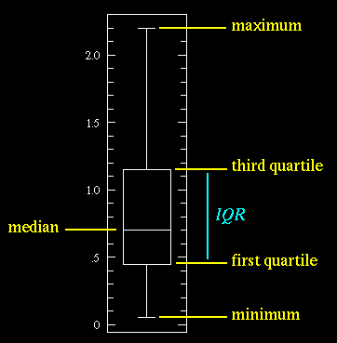
Boxplots
VFrench, 2017

Slide 14
Outliers
Because the min and max may be outliers, a variation on the boxplot includes “fences” to show where most of the data occurs

Slide 15
Outliers
Lower fence:
Q1 - 1.5 * IQR
Upper fence:
Q3 + 1.5 * IQR

Slide 16
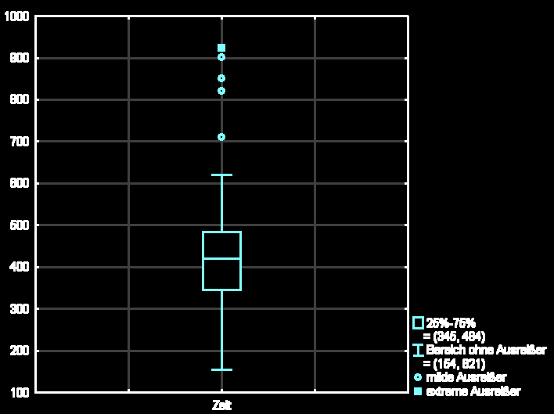
Outliers
How outliers are shown in a boxplot

Slide 17
Boxplots
Boxplots are typically used to compare different groups

Slide 18
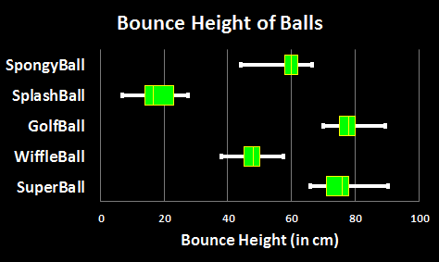
Boxplots
What differences?
C
A
Different
Different
Different
E
B
Not different
D
VFrench, 2012

Slide 19

Stuff You Ignored When I Said It
Do NOT use the quartile function in Excel

Slide 20

Stuff You Ignored When I Said It
Do NOT use the quartile function in Excel
It gives the WRONG answers

Slide 21

Questions?
http://i.imgur.com/aliTlT3.jpg

Slide 22
Descriptive Statistics
We take a sample to find out something about the whole population

Slide 23
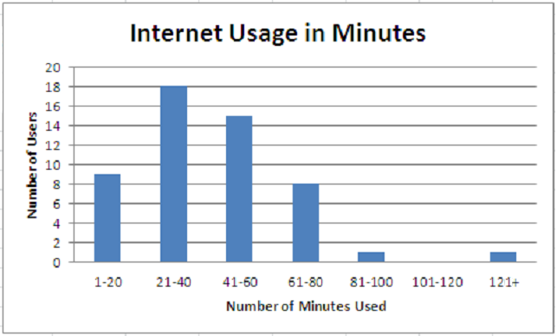
Descriptive Statistics
We can learn a lot about
our population
by graphing the data:
VFrench, 2017

Slide 24
Descriptive Statistics
But it would also be convenient
to be able to “explain” or describe the population
in a few summary words or numbers based on our data

Slide 25
Descriptive Statistics
But it would also be convenient
to be able to “explain” or describe the population
in a few summary words or numbers based on our data
Kinda-like a 5-number summary

Slide 26
Descriptive Statistics
The maximum or minimum values from our sample can help describe or summarize our data
VFrench, 2017

Slide 27
Descriptive Statistics
More often than not we want a single number (not another table of numbers) to help summarize our data

Slide 28
Descriptive Statistics
One way to do this is to find a number that gives a “usual” or “normal” or “typical” observation

Slide 29
Averages
What do we usually think of as
“The Average”?
Data:
3 1 4 1 1
Average = _________ ?

Slide 30

Averages
If you add up all the data values and divide by the number of data points, this is not called the “average” in
Statistics
Class
It’s called the
“arithmetic mean”
http://forums.penny-arcade.com/discussion/128719/jenspiration-the-ups-and-downs-of-working-traditionally/aagh.jpg

Slide 31
Averages
…and “arithmetic” isn’t pronounced “arithmetic” but “arithmetic”

Slide 32

Averages
More bad news…
It’s bad enough that statisticians gave this a
wacky name, but…
IT’S NOT THE ONLY “AVERAGE”
https://www.yourdictionary.com/images/main.shriek.jpg

Slide 33
Averages
In statistics, we not only have the good ol’ “arithmetic mean” average, we also have:
- median
- midrange
- mode

Slide 34

And…
Since all these are called
“average”
There is lots of room for statistical skullduggery
and lying!
VFrench, 2010

Slide 35
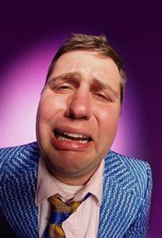
And…
Of course, statisticians can’t call them “averages” like everyone else
In Statistics class they are called
“Measures of
Central Tendency”
http://www.gettyimages.com/detail/photo/businessman-crying-close-up-high-res-stock-photography/AB34183

Slide 36
Measures of Central Tendency
The averages give an idea of where the data “lump together”
Or “center”
Where they “tend to center”

Slide 37
Measures of Central Tendency
Mean = sum of obs/# of obs
Median = the middle obs
(ordered data)
Midrange = (Max+Min)/2
Mode = the most common value

Slide 38
Measures of Central Tendency
The “arithmetic mean” is what normal people call the average

Slide 39

Measures of Central Tendency
The arithmetic mean for your sample is called “$\overline{\text{x}}$”
Pronounced “x-bar”

Slide 40
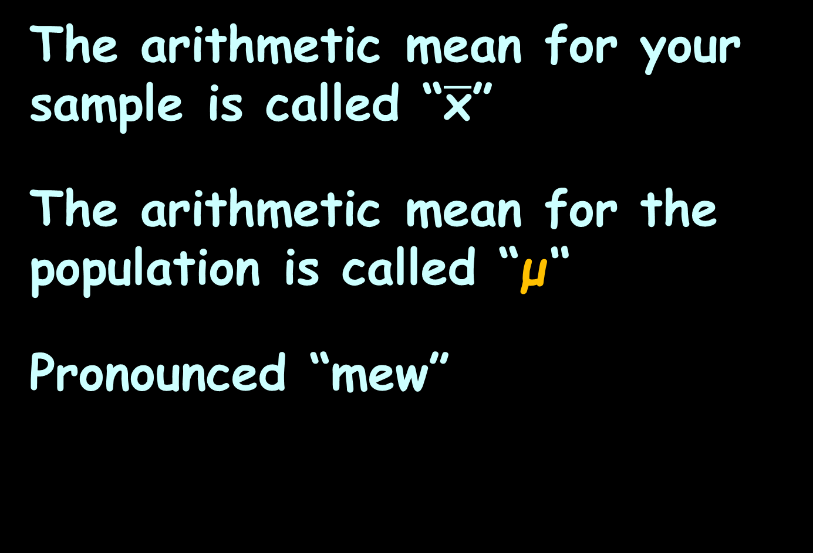
Measures of Central Tendency
The arithmetic mean for your sample is called “$\overline{\text{x}}$”
The arithmetic mean for the population is called “μ“
Pronounced “mew”

Slide 41
Measures of Central Tendency
Remember we use sample statistics to estimate population parameters?
Our sample arithmetic mean estimates the (unknown) population arithmetic mean

Slide 42
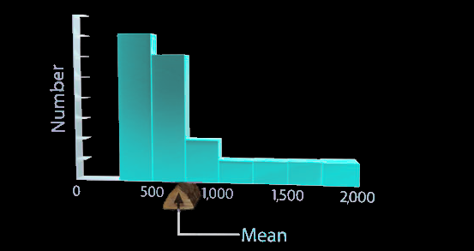
Measures of Central Tendency
The arithmetic mean is also the balance point for the data
VFrench, 2012

Slide 43
Measures of Central Tendency
Median = the middle obs
(ordered data)
(Remember we ordered the data to create categories from measurement data?)

Slide 44
Measures of Central Tendency
Data:
3 1 4 1 1
Next, order the data!

Slide 45
Measures of Central Tendency
Ordered data:
1 1 1 3 4
So, which is the middle observation in the ordered data?

Slide 46
Measures of Central Tendency
Ordered data:
1 1 1 3 4
group 1
group 2
(median)

Slide 47
Measures of Central Tendency
If you have an even number of observations, you take the average (arithmetic mean) of the two middle observations
1 1 1 3 4 7
group 1
group 2
median = (1+3)/2
= 2

Slide 48
Measures of Central Tendency
Mode = the most common value

Slide 49
Measures of Central Tendency
What if there are two?
3 1 4 1 3

Slide 50
Measures of Central Tendency
What if there are two?
3 1 4 1 3
You have two modes: 1 and 3

Slide 51
Measures of Central Tendency
What if there are none?
62.3 1 4 2 3

Slide 52
Measures of Central Tendency
Then there are none…
62.3 1 4 2 3
Mode = #N/A

Slide 53
Measures of Central Tendency
The mode will ALWAYS be one of the observed values!

Slide 54
How to Lie with Statistics
Data set: Wall Street Bonuses
CEO $5,000,000
COO $3,000,000
CFO $2,000,000
3VPs $1,000,000
5 top traders $ 500,000
9 heads of dept $ 100,000
51 employees $ 0

Slide 55
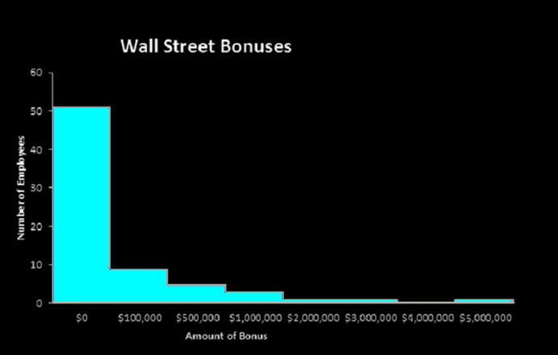
How to Lie with Statistics
You would enter the data in Excel including the 51 zeros
VFrench, 2012

Slide 56
How to Lie with Statistics
Excel Summary Table:
Wall Street Bonuses
Mean | $ 230,985.90
Median | $ 0.00
Mode | $ 0.00
Midrange | $2,500,000.00
VFrench, 2012

Slide 57

How to Lie with Statistics
Since all of
these are
“averages”
you can use
whichever one
you like…
Wall Street Bonuses
Mean | $ 230,985.90
Median | $ 0.00
Mode | $ 0.00
Midrange | $2,500,000.00
http://www.jacquelineabelson.com/uploads/2/1/0/2/21022616/4633436.gif?272

Slide 58
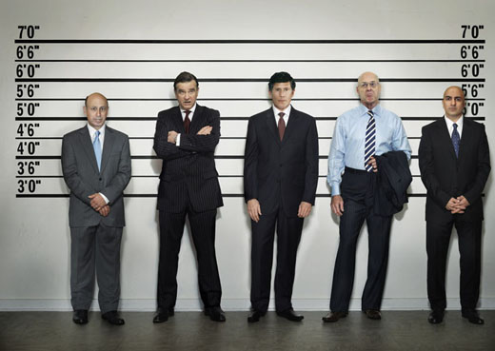
HOW TO LIE WITH AVERAGES
IN-CLASS PROBLEM 1a
Which one would
you use to show
this company is
evil?
Wall Street Bonuses
Mean | $ 230,985.90
Median | $ 0.00
Mode | $ 0.00
Midrange | $2,500,000.00
http://static.seekingalpha.com/uploads/2010/5/3/saupload_goldman_large.jpg

Slide 59

HOW TO LIE WITH AVERAGES
IN-CLASS PROBLEM 1b
Which one could you use to show the company is not paying
any bonuses?
Wall Street Bonuses
Mean | $ 230,985.90
Median | $ 0.00
Mode | $ 0.00
Midrange | $2,500,000.00
https%3A%2F%2Favopix.com%2Fpremium-vector%2F1868154340-shutterstock-angel-businessman-with-checklist-sign&tbnid

Slide 60
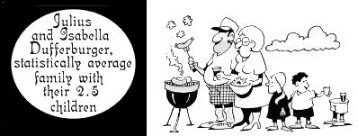
HOW TO LIE WITH AVERAGES
#1
The average we get may not have any real meaning
https://s3.amazonaws.com/lowres.cartoonstock.com/families-2-2-statistic-statistically_average-averages-mly0988_low.jpg

Slide 61
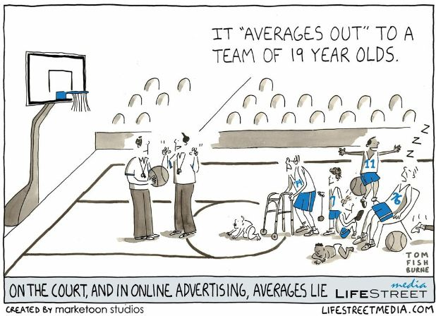
HOW TO LIE WITH AVERAGES
#2

Slide 62
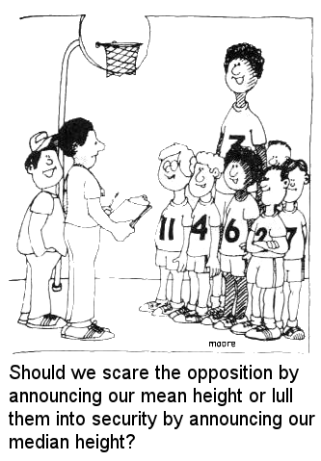
HOW TO LIE WITH AVERAGES
#3
http://www-users.york.ac.uk/~pml1/bayes/cartoons/cartoon13.jpg

Slide 63
Questions?
http://i.imgur.com/aliTlT3.jpg

Slide 64
Descriptive Statistics
Averages tell where the data tends to pile up

Slide 65
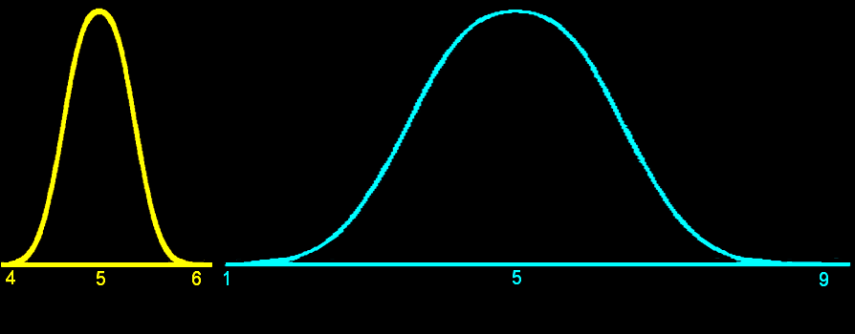
Descriptive Statistics
Another good way to describe data is how spread out it is
VFrench, 2012

Slide 66
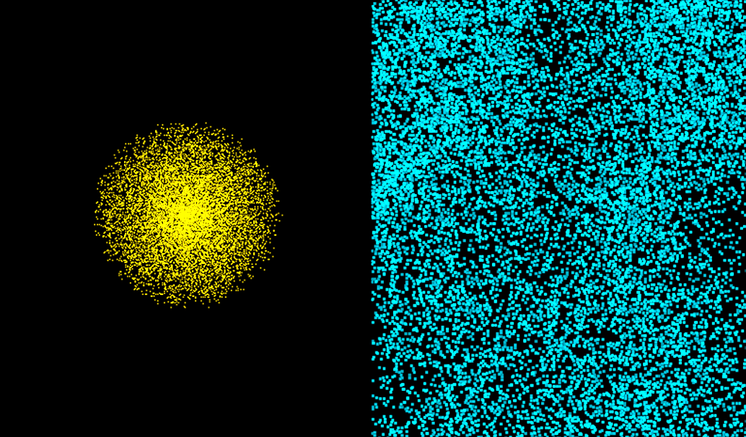
VARIABILITY
IN-CLASS PROBLEM 2
Which is more spread out?
VFrench, 2012

Slide 67
Variability
Numbers telling how spread out our data values are
are called
“Measures of Variability”
dispersion

Slide 68
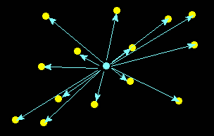
Variability
The variability tells how close to the “average” the sample data tend to be
VFrench, 2012

Slide 69
Variability
Just like measures of central tendency, there are several measures of variability

Slide 70
Variability
Range = R = max – min

Slide 71

Variability
Variance (symbolized s²)
s² =
sum of (obs – $\overline{\text{x}}$)²
n - 1

Slide 72

Variability
Standard deviation (symbolized “s” or “std”)
s = $\sqrt{\text{v}\text{ariance}}$

Slide 73
Variability
The range and standard deviation are in the same units as the original data (a good thing)
The variance is in squared units (which can be confusing…)

Slide 74
Variability
Naturally, the measure of variability used most often is the hard-to-calculate one…

Slide 75
Variability
Naturally, the measure of variability used most often is the hard-to-calculate one…
… the standard deviation

Slide 76
Variability
Statisticians like it because it is an average distance of all of the data from the center – the arithmetic mean
VFrench, 2012

Slide 77
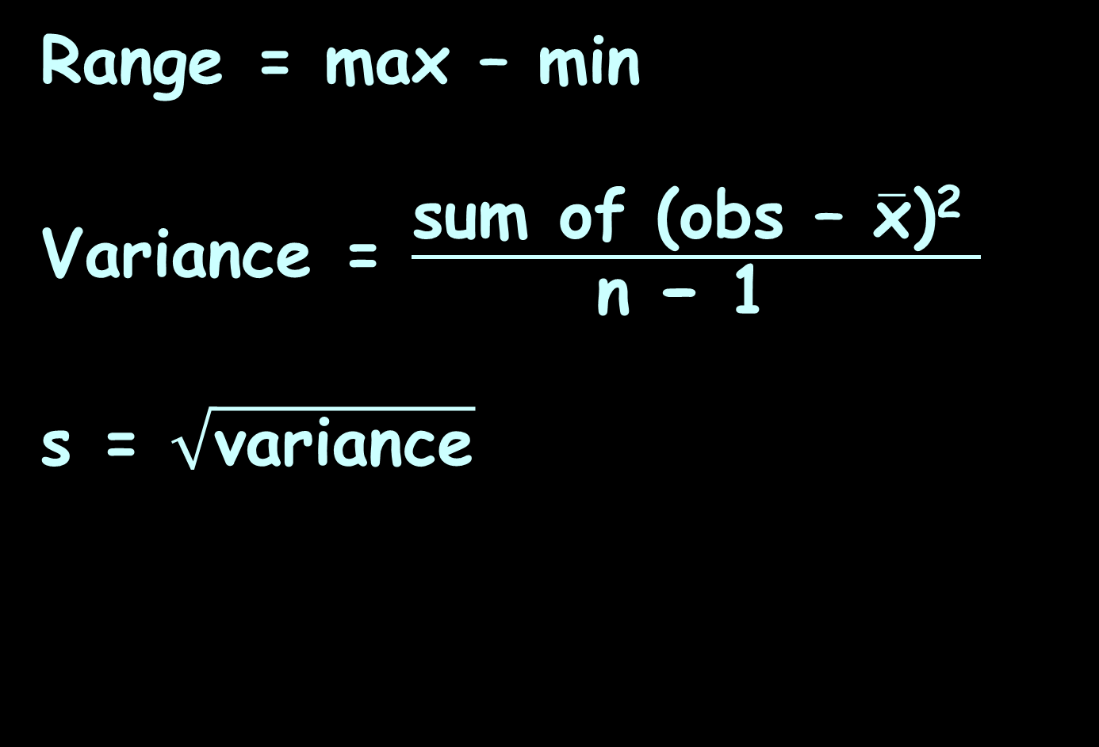
Variability
Range = max – min
Variance = $\frac{\text{sum} \text{of}\text{ (}\text{obs}\text{ – }\overline{\text{x}}\text{)}\text{2 }}{\text{n}\text{ − 1 }}$
s = $\sqrt{\text{variance}}$

Slide 78

Variability
Aren’t you glad Excel
does all this for you???
dreamstime.com

Slide 79
Variability
Another measure of variability:
IQR = Q3 – Q1

Slide 80
Variability
Other (twin) measures of variability:
Lower fence:
Q1 - 1.5 * IQR
Upper fence:
Q3 + 1.5 * IQR

Slide 81

Variability
Just like for n and N
and $\overline{\text{x}}$ and μ there are population variability symbols, too!

Slide 82

Variability
Naturally, these are going to have funny Greek-y symbols just like the averages …
http://transinformation.net/wp-content/uploads/2015/09/zeus-greek-mythology-687267_1024_768.jpeg

Slide 83
Variability
The population variance
is “σ²”
called “sigma-squared”
The population standard deviation is “σ”
called “sigma”

Slide 84
Variability
Again, the sample statistics s² and s values estimate population parameters σ² and σ (which are unknown)

Slide 85
Variability
s sq “s²”
vs
sigma sq “σ²”

Slide 86
Variability
s² is divided by “n-1”
σ² is divided by “N”

Slide 87
Questions?
http://i.imgur.com/aliTlT3.jpg

Slide 88
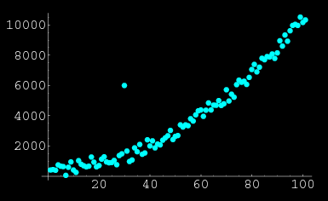
Outliers
Remember I said you always need to graph your data?
outlier
http://mathworld.wolfram.com/images/eps-gif/OutlierScatterplot_1000.gif

Slide 89
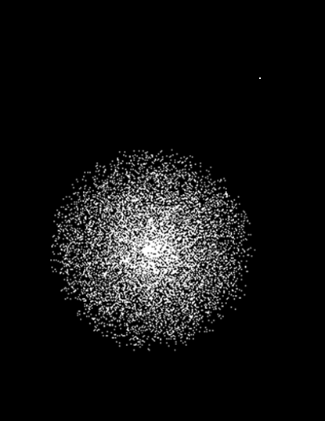
Variability
Outlier!
VFrench, 2012

Slide 90
Outliers
That’s because outliers can affect your summary statistics
outlier
VFrench, 2013

Slide 91
HOW TO LIE WITH AVERAGES
IN-CLASS PROBLEM 3
Which are affected by the large bonus being paid to the CEO?
Wall Street Bonuses
Mean | $ 230,985.90
Median | $ 0.00
Mode | $ 0.00
Midrange | $2,500,000.00

Slide 92
OUTLIERS
IN-CLASS PROBLEMS 3a
Suppose we originally had data:
1 1 1 2 3 5
Suppose we now have data:
1 1 1 2 3 741
Is the mode affected?

Slide 93
OUTLIERS
IN-CLASS PROBLEMS 3a
Suppose we originally had data:
1 1 1 2 3 5
Suppose we now have data:
1 1 1 2 3 741
Original mode: 1
New mode: 1

Slide 94
OUTLIERS
IN-CLASS PROBLEMS 3b
Suppose we originally had data:
1 1 1 2 3 5
Suppose we now have data:
1 1 1 2 3 741
Is the midrange affected?

Slide 95
OUTLIERS
IN-CLASS PROBLEMS 3b
Suppose we originally had data:
1 1 1 2 3 5
Suppose we now have data:
1 1 1 2 3 741
Original midrange: 3
New midrange: 371

Slide 96
OUTLIERS
IN-CLASS PROBLEMS 3c
Suppose we originally had data:
1 1 1 2 3 5
Suppose we now have data:
1 1 1 2 3 741
Is the median affected?

Slide 97
OUTLIERS
IN-CLASS PROBLEMS 3c
Suppose we originally had data:
1 1 1 2 3 5
Suppose we now have data:
1 1 1 2 3 741
Original median: 1.5
New median: 1.5

Slide 98
OUTLIERS
IN-CLASS PROBLEMS 3d
Suppose we originally had data:
1 1 1 2 3 5
Suppose we now have data:
1 1 1 2 3 741
Is the mean affected?

Slide 99
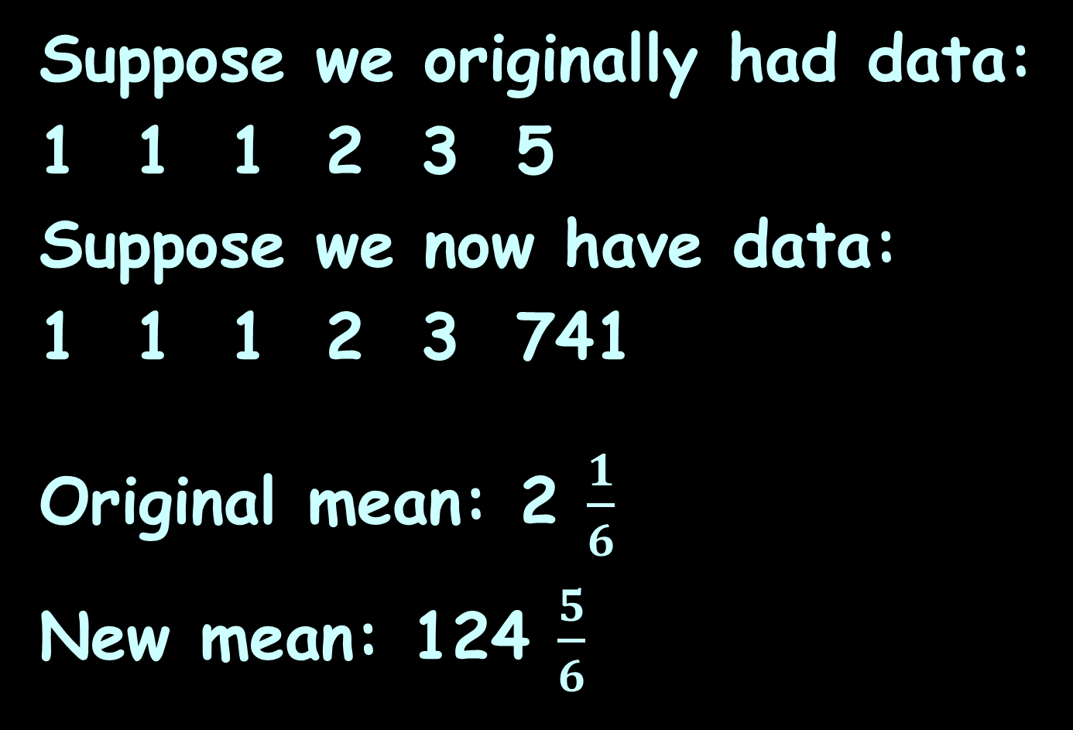
OUTLIERS
IN-CLASS PROBLEMS 3d
Suppose we originally had data:
1 1 1 2 3 5
Suppose we now have data:
1 1 1 2 3 741
Original mean: 2 $\frac{1}{6}$
New mean: 124 $\frac{5}{6}$

Slide 100
Questions?
http://i.imgur.com/aliTlT3.jpg

Slide 101
Outliers!
How about measures of variability?

Slide 102
OUTLIERS
IN-CLASS PROBLEMS 3e
Suppose we originally had data:
1 1 1 2 3 5
Suppose we now have data:
1 1 1 2 3 741
Is the range affected?

Slide 103
OUTLIERS
IN-CLASS PROBLEMS 3e
Suppose we originally had data:
1 1 1 2 3 5
Suppose we now have data:
1 1 1 2 3 741
Original range: 4
New range: 740

Slide 104
OUTLIERS
IN-CLASS PROBLEMS 3f
Suppose we originally had data:
1 1 1 2 3 5
Suppose we now have data:
1 1 1 2 3 741
Is the interquartile range affected?

Slide 105
OUTLIERS
IN-CLASS PROBLEMS 3f
Suppose we originally had data:
1 1 1 2 3 5
Suppose we now have data:
1 1 1 2 3 741
Original IQR: 3 – 1 = 2
New IQR: 2

Slide 106
OUTLIERS
IN-CLASS PROBLEMS 3g
Suppose we originally had data:
1 1 1 2 3 5
Suppose we now have data:
1 1 1 2 3 741
Is the variance affected?

Slide 107
OUTLIERS
IN-CLASS PROBLEMS 3g
Suppose we originally had data:
1 1 1 2 3 5
Suppose we now have data:
1 1 1 2 3 741
Original s²: ≈2.57
New s²: ≈91,119.37

Slide 108
OUTLIERS
IN-CLASS PROBLEMS 3h
Suppose we originally had data:
1 1 1 2 3 5
Suppose we now have data:
1 1 1 2 3 741
Is the standard deviation affected?

Slide 109
OUTLIERS
IN-CLASS PROBLEMS 3h
Suppose we originally had data:
1 1 1 2 3 5
Suppose we now have data:
1 1 1 2 3 741
Original s: ≈1.60
New s: ≈301.86

Slide 110
Questions?
http://i.imgur.com/aliTlT3.jpg

Slide 111
Descriptive Statistics in Excel
Open the Excel spreadsheet
Go to the “Descriptive” page

Slide 112
Multiple Comparisons
Ok… swell… but
WHAT DO YOU USE ALL THESE STATISTICS FOR???

Slide 113
Multiple Comparisons
Make a graph that includes not just the average, but also the spread of the measurements!

Slide 114
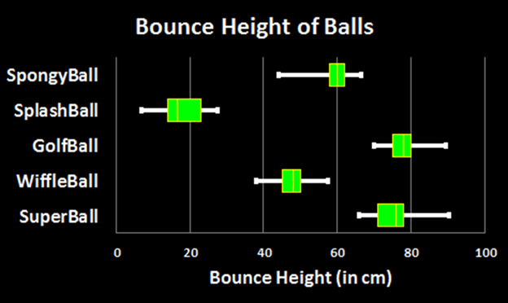
Multiple Comparisons
Boxplots do this!
VFrench, 2012

Slide 115
Multiple Comparisons
Boxplots show the median (a measure of central tendency) and two measures of variability:
the IQR (from Q1 to Q3) and range (from
max to min)
VFrench, 2012

Slide 116
Multiple Comparisons
But… doing boxplots in Excel had some problems…
VFrench, 2012

Slide 117
Multiple Comparisons
But… doing boxplots in Excel had some problems…
…like that Excel's formulas for Q1 and Q3 are non-standard
VFrench, 2012

Slide 118
Multiple Comparisons
But… doing boxplots in Excel had some problems…
…and that Excel doesn’t allow you to use other measures of central
tendency or
variability
VFrench, 2016

Slide 119
Multiple Comparisons
A graph including both a measure of central tendency and a measure of variability is called a
“Multiple Comparison Graph”

Slide 120
Multiple Comparisons
New Excel Graph:
high-low-close

Slide 121
Multiple Comparisons
These are flexible enough to allow you to use any measure of central tendency and variability you want

Slide 122

Multiple Comparisons
But they are cranky about the format of your inputs – you have to have certain inputs in a certain order
for them to
work properly
http://scottsauls.com/wp-content/uploads/2015/06/Shame.jpg

Slide 123
MULTIPLE COMPARISON GRAPHS
IN-CLASS PROBLEMS 4a
Intoxication from Cocktails
After drinking 2 of the same colored-coded cocktails, subjects wait 1 hour and are breathalyzer tested for blood alcohol level

Slide 124
MULTIPLE COMPARISON GRAPHS
IN-CLASS PROBLEMS 4a
Intoxication from Cocktails
Create a Descriptive Statistics Summary Table using the Excel Add-In
Make it “purty”
(Note: this will end up on another sheet)

Slide 125
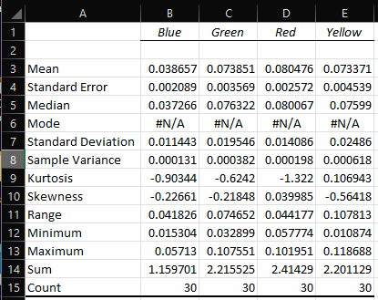
MULTIPLE COMPARISON GRAPHS
IN-CLASS PROBLEMS 4a
If it doesn’t look like this, it ain’t “purty”:
VFrench, 2022

Slide 126
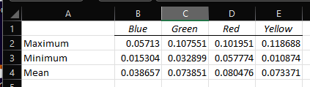
MULTIPLE COMPARISON GRAPHS
IN-CLASS PROBLEMS 4b
Create an MCG
Rearrange a new table so it has:
Labels
Maximum
Minimum
Mean
If it’s not like this in this order, the MCG won’t work!
VFrench, 2022

Slide 127
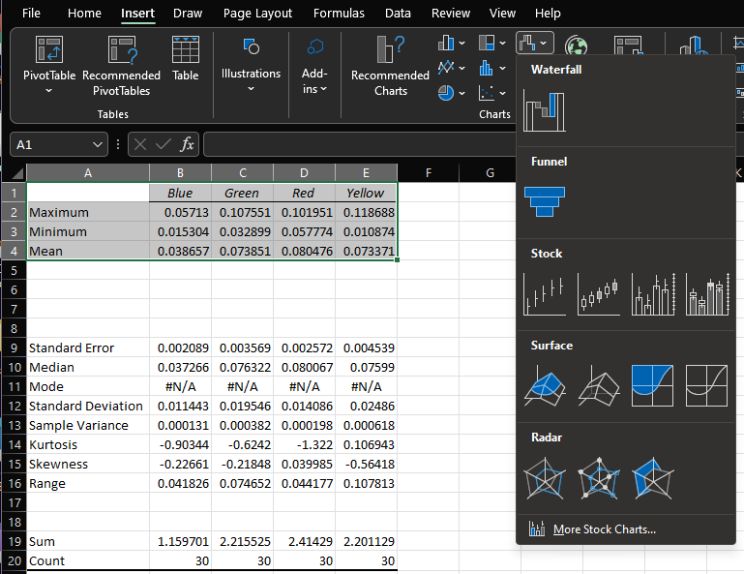
MULTIPLE COMPARISON GRAPHS
IN-CLASS PROBLEMS 4b
Highlight this new summary data table
Click “Insert”
Hunt for
an “icicle”-
shaped icon
VFrench, 2022

Slide 128
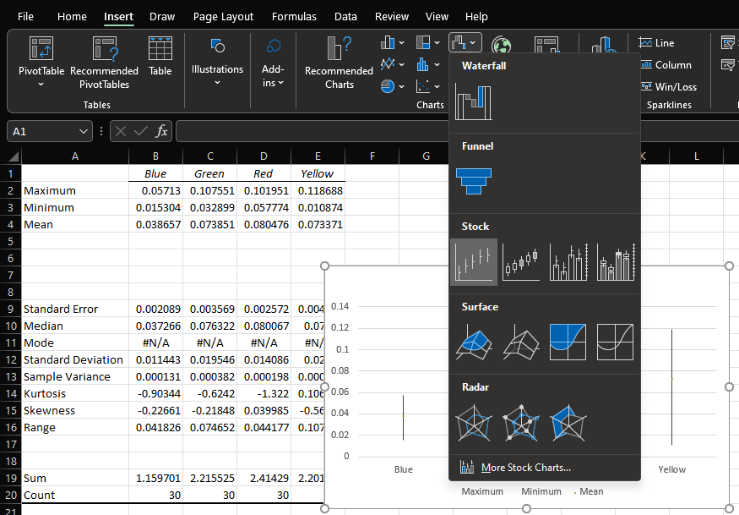
Click the first “Stock” pic
VFrench, 2022

Slide 129
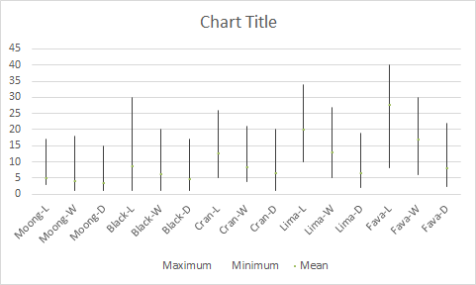
This is called a “hi-lo-close graph
Ugly… as usual …but… informative!
VFrench, 2018

Slide 130
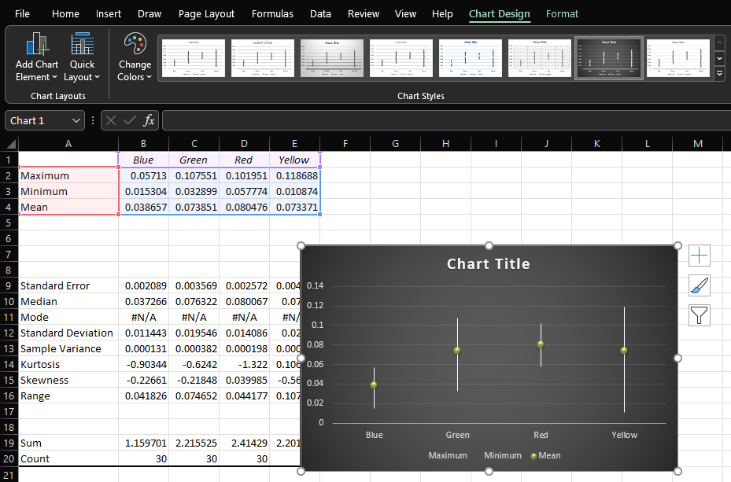
Click the Chart Design tab
Select one you like
VFrench, 2022

Slide 131
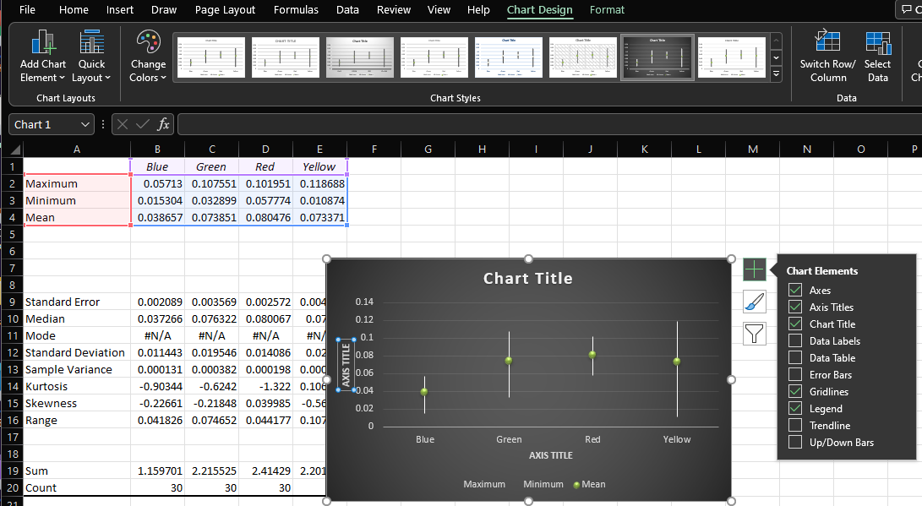
Click the + sign
VFrench, 2022

Slide 132
Make sure Axes, Axis Titles, Chart Title and Legend are “on”
VFrench, 2022

Slide 133
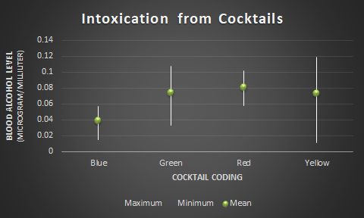
Fill in titles:
VFrench, 2022

Slide 134
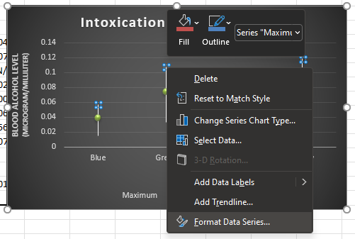
Right click on any top of a line (the “Maximum”) and select “Format Data Series”
VFrench, 2022

Slide 135
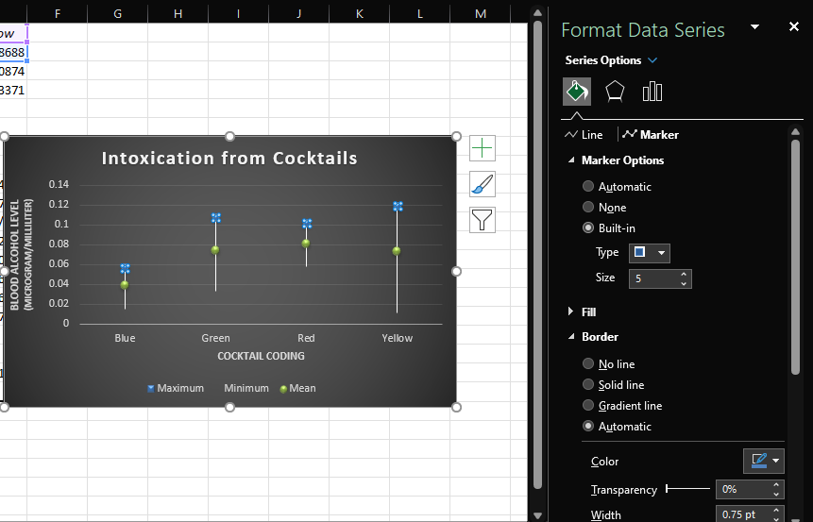
Click on “Paint can”, “Marker” and “Marker Options” then “Built-in”
VFrench, 2022

Slide 136
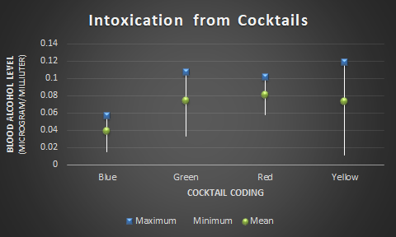
Poof! Now it is easier to see the “Max” values
VFrench, 2022

Slide 137
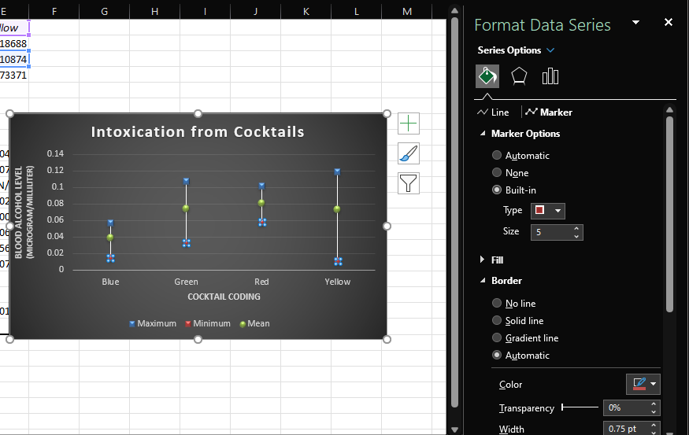
Right click on any bottom of a line (the “Minimum”) do the same steps
VFrench, 2022

Slide 138
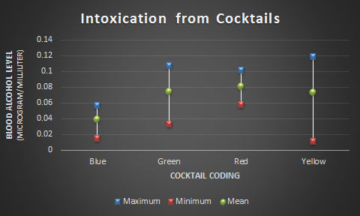
TAH DAH! So… what does this graph show?
VFrench, 2022

Slide 139
4c) Which cocktail is least likely to get you pulled over for DUI? Why?
Highest Max
Highest Mean
Lowest Max
Lowest Mean
Lowest Min
VFrench, 2022

Slide 140
4d) Which cocktail is most likely to get you pulled over for DUI? Why?
Highest Max
Highest Mean
Lowest Max
Lowest Mean
Lowest Min
VFrench, 2022

Slide 141
Multiple Comparisons
These graphs (at this point) are a little hard to explain! We’ll have an adjusted version later that will allow you to make more comparisons and draw more informed conclusions

Slide 142
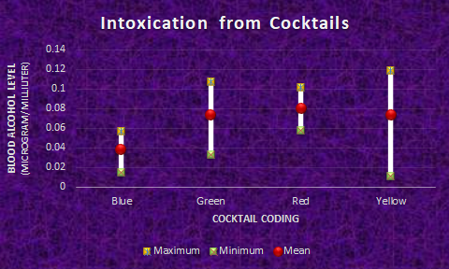
This is your chance to be an individual! All pieces of the graph can be personalized with colors, symbols, and sizes!!
VFrench, 2022

Slide 143
Questions?
http://i.imgur.com/aliTlT3.jpg

Slide 144
Summary
Today we studied:
Review of frequencies
Descriptive statistics:
Measures of central tendency:
mean, median, mode, midrange
Measures of variability:
IQR, range, variance,
standard deviation
Multiple Comparison Graphs

Slide 145

You Survived!
www.playbuzz.com

