Slide 1

ELECTRICITY
TRENT STROTHKAMP
3 MARCH 2020
SCI 101 Introduction to Science

Slide 2

HOW DOES ELECTRICITY MOVE?

Slide 3
INTERESTING?
Not many people know how electricity moves from one place to another.

Slide 4
The process of electricity begins when energy from light, heat, or magnetic fields stimulates an atom's electrons, making them move.
BACKGROUND

Slide 5
Some atoms hold their electrons close to the nucleus and some don't. The atoms with a loose hold on their electrons are best at conducting an electrical current.
BACKGROUND

Slide 6
When an outside force (battery) acts upon an element like copper electrons are "lost" from an atom, the free movement of these electrons constitutes an electric current.
BACKGROUND

Slide 7
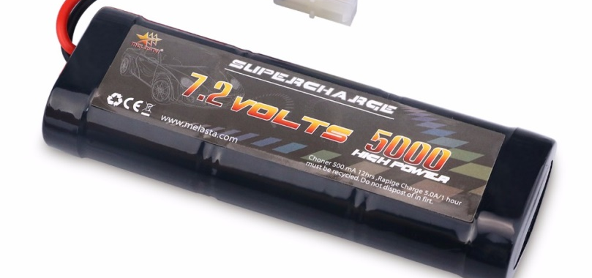
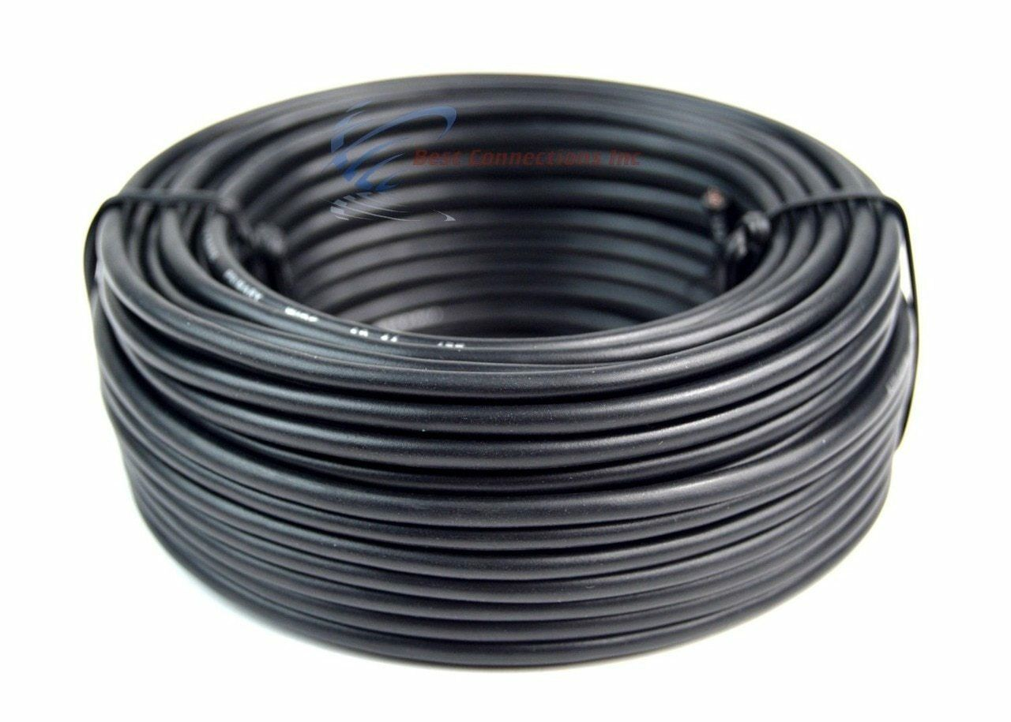
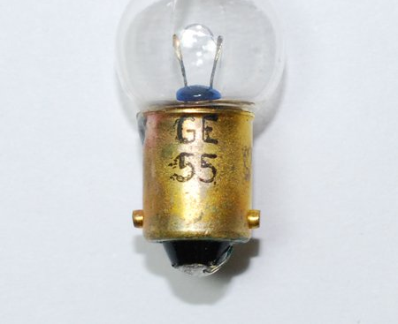
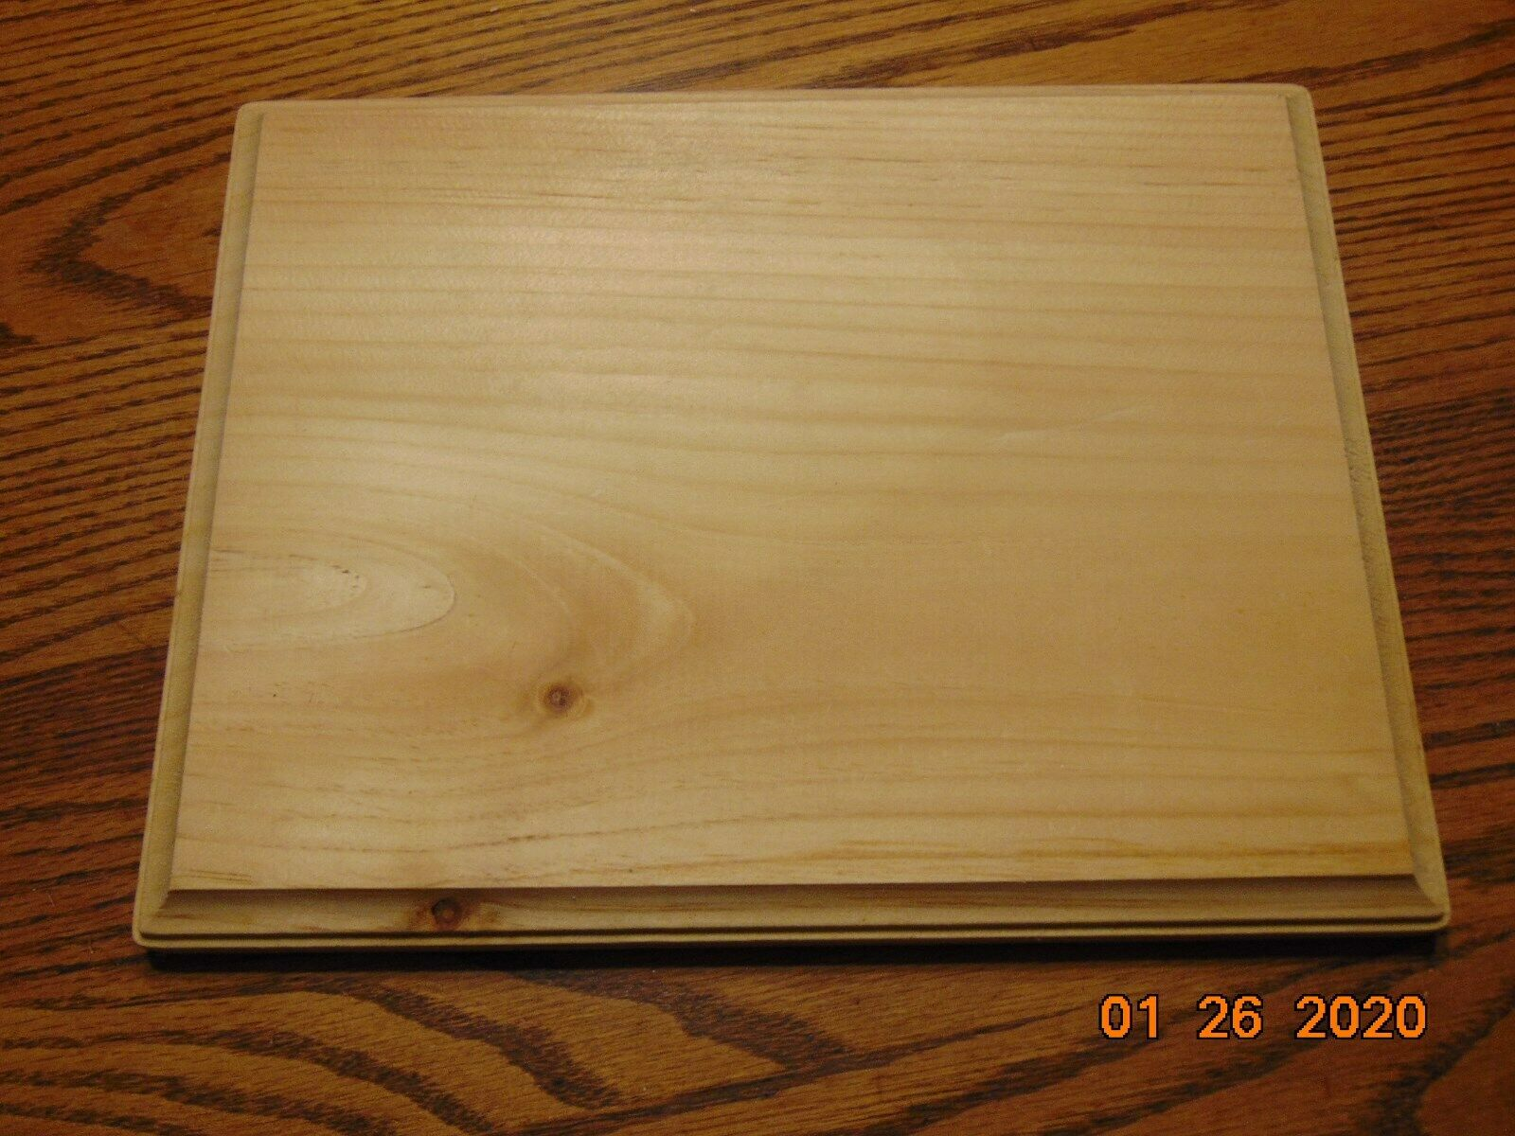
What you need
1. Base ( wood or something that doesn’t conduct)
2. Wire (with and without insulation)
3. Battery
4. Light (that can handle the voltage of battery)
EBAY (1 Mar 2020)
EBAY (1 Mar 2020)
Bulb America (3 Mar 2020)
EBAY (1 Mar 2020)

Slide 8
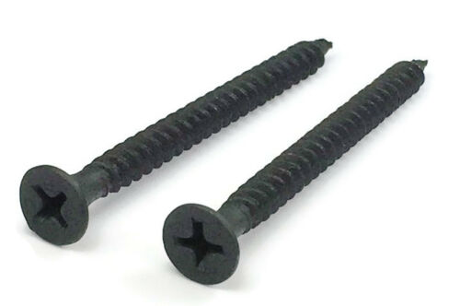
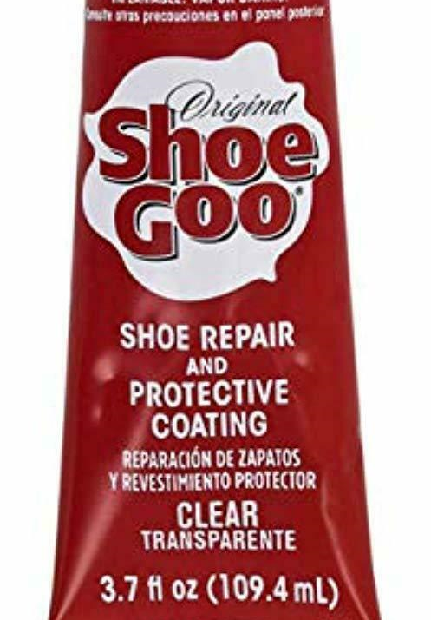
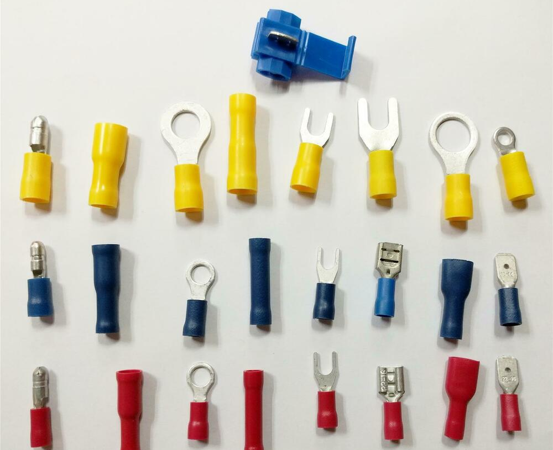
5. Screws
6. Glue
7. Connectors
EBAY (1 Mar 2020)
EBAY (1 Mar 2020)
Ebay (1 March 2020)

Slide 9
HOW TO DO IT
What I made is a wire loop game commonly used at fairs, is a game which involves moving a metal loop along a length of wire without touching the loop to the wire. The loop and wire are connected to a battery so if they touch, they form a closed electric circuit. The wire is connected to a light, so that when the loop and the wire touch, the light will light up.

Slide 10
HOW TO DO IT
Move the loop around wire and don’t touch.
If you touch the wire the light will come on and you lose.

Slide 11
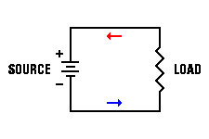
HOW TO DO IT
This demonstrates a complete D/C circuit.
Codrey (July 26, 2018)

Slide 12
SUMMARY
How electricity moves.
What the wire loop game is.
What you need to build one.
How to play it.

Slide 13
REFERENCES
- French, V . (2019) sci101 class lecture on electromagnetism.
Personal collection of v. French, Colorado Technical University, Aurora Co.
- Jeanty, J . (2020). Retrieved from
https://www.techwalla.com/articles/how-does-electricity-work
- Bellis, M. (September 24, 2018). Retrieved from
https://www.thoughtco.com/what-is-electricity-4019643
- Ebay. (1 March 2020). Retrieved from
https://www.ebay.com/itm/1pc-GTL-7-2V-4600mAh-Ni-Mh-Rechargeable-Battery-Pack-For-RC-Car-With-Tamiya-Plug/143410774887?hash=item2163f2c367:g:QsYAAOSwtAhdXyug
- Ebay. (3 Mar 2020). Retrieved from
https://www.ebay.com/itm/Unfinished-Wooden-Plaque-Stand-Base-Sign-natural-wood-DIY/223893034330?var=522639174805&hash=item342110955a:g:LHIAAOSwjydeOP84

Slide 14
- Bulb America. (3 Mar 2020). Retrieved from
https://www.bulbamerica.com/products/ge-3w-g4-5-g4-1-2-7v-automotive-low-voltage
- Ebay. (3 Mar 2020). Retrieved from
http://i.ebayimg.com/images/i/182153497028-0-1/s-l1000.jpg
- Ebay. (3 Mar 2020). Retrieved from
https://www.ebay.com/itm/6-Black-Philips-Bugle-Head-Fine-Thread-Sharp-Point-Drywall-Screws
- Ebay. (3 Mar 2020). Retrieved from
https://www.ebay.com/itm/SHOE-GOO
- Ebay. (3 Mar 2020). Retrieved from
https://i.ebayimg.com/images/i/361481409690-0-1/s-l1000.jpg
- Codrey. (July 26, 2018). Retrieved from
https://www.codrey.com/wp-content/uploads/2018/07/Alternating-Current-AC-and-Direct-Current-DC-Direction-of-current.png

